Slide 1

Product Management
Certification Program
Industry Project - I
Notes:
© Copyright UpGrad Education Pvt. Ltd. All rights reserved

Slide 2
Submission Guidelines
After completing all the parts of the project, you will have to submit your responses in the following manner.
Submit the following parts of the project in this “Presentation’’ file
Part 1 - Understanding the market
Part 2 - User research
Part 5 - MVP Creation
Part 6 - Sketching
Part 7 - Wireframing & Prototyping
Submit the following part of the project in the template document provided on the platform.
Part 3 - Business Model Canvas
Part 4 - Product Artifacts
User Persona
User Journey Map
Note: Finally you have to add this Presentation & other submission documents in a ZIP folder and upload it in the submission section on the platform. More details in slides to follow
Notes:
© Copyright UpGrad Education Pvt. Ltd. All rights reserved

Slide 3
Part 1: Understanding the Market
Notes:
© Copyright UpGrad Education Pvt. Ltd. All rights reserved

Slide 4
Total Market Identification
Criteria | Target Audience
Age | 18years - 35years
Gender | Male, Female, and Non-binary
Marital Status | Single, Domestic Relationship, and Married
Location | Tier 1 and Tier 2 cities
Occupation | Students and Working Professionals
Technology | Android, iOS, and Windows smartphones
Motivation | Students and working professionals who doesn’t stay at their home and can’t cook food Married couples who doesn’t want to cook and want it on demand People would like to order food online when they are partying at home or have friends/family over Discounted prices and doesn’t want to go out
Notes:
© Copyright UpGrad Education Pvt. Ltd. All rights reserved

Slide 5
Total Available Market
There are two ways to identify the population size:
Guesstimate technique
With the help of resources like Facebook Ad Manager and IndiaStats
We used Guesstimate technique to get the total available market.
The total population of India is approximated to 1.3 billion
The ratio of urban to rural population is 30:70
Urban population = 0.3 x 1.3 billion = 390 million
The online food delivery services will be more used in urban areas
So, the population of 390 million falls under the urban population
Now the online food ordering will require an internet connection
Assuming around 70% of internet penetration in the urban areas i.e., 0.7*390 million = 273 million
The total available market is approximated to 273 million accounts.
Notes:
© Copyright UpGrad Education Pvt. Ltd. All rights reserved

Slide 6
Serviceable Available Market
From 273 million accounts from Urban areas the online food delivery had set footprints in tier 1 and tier 2 cities.
Assuming the 70% urban population resides in tier 1 and tier 2 cities.
The population in tier 1 and tier 2 cities who can use online food delivery are around
70% of 273 million = 191 million
There would be kids and senior citizens who are dependent on someone to order food for them.
Assuming Population Distribution –
Age : Percentage
0–17. : 25%
18- 60 : 60%
More than 60 : 15
So, the food ordering age group will be around 60% of 191 million which is around 115 million users.
The serviceable available market is 115 million users.
Notes:
© Copyright UpGrad Education Pvt. Ltd. All rights reserved

Slide 7
Target Market
Now, as to start a new service we can focus the service to tier 1 cities
The population distribution is high in tier one cities as compared to tier 2
So, assuming the distribution ratio of tier 1 to tier 2 is 60:40
So, the number of users available from tier 1 cities would be 60% of 115 million = 69 million
The online delivery is frequently used by the age group 18-35
As this age group is mostly staying away from the hometown and mostly are students and working professionals. With no or average cooking skills or lack of time availability.
In tier 1 cities the working professionals and students are in majority, and we already had calculated age group to 18-60
So, assuming the ratio of age groups 18 - 35 : 35 - 60 is around 60:40, i.e., 60% of 69 million approximated to 40 million users
The target market is around 40 million users
Notes:
© Copyright UpGrad Education Pvt. Ltd. All rights reserved

Slide 8
Porter's Five Forces Analysis
The tool was created by Harvard Business School professor Michael Porter, to an industry’s attractiveness and likely profitability.
He identified Five Forces that make up the competitive environment, and which can erode your profitability.
These are:
Competitive Rivalry: This looks at the number and strength of your competitors
Supplier Power: This is determined by how easy it is for your suppliers to increase their prices
Buyer Power: Here, you ask yourself how easy it is for buyers to drive your prices down
Threat of substitution: This refers to the likelihood of your customers finding a different way of doing what you do
Threat of new entry: Your position can be affected by people’s ability to enter your market
Notes:
© Copyright UpGrad Education Pvt. Ltd. All rights reserved

Slide 9
Competitive Rivalry
The competitive rivalry is High
We have giant competitors in the market already like Swiggy and Zomato who already have a good hold of the market and reach as well
Acquisition of companies like UberEats and Foodpanda show the tough competition in the Food tech industry
They(Swiggy and Zomato especially) are very well-funded companies who have a lot of money to market themselves and expand their reach. Also, they have a huge team working on gaining customer & vendor loyalty at the same time take the competitive rivalry on the higher side
Rivalry in this industry is heating up. Above point indicates, there is a huge competition in the market and 2 giant players(Swiggy and Zomato) are burning at a very high level. Indian food delivery industry is getting converted from Blue ocean to Red Ocean, with this rivalry. Acquisition of Ubereats by Zomato shows the difficulty to survive in this market, defining competition rivalry to High.
Notes:
© Copyright UpGrad Education Pvt. Ltd. All rights reserved

Slide 10
Supplier Power
Bargaining power of Suppliers is Moderate to High
Fluctuation in the prices of commodities directly impacts the production cost, especially when the prices increase, and this promotes the bargaining power of the suppliers
To ensure consistent supplies for the planned production, annual price contracts become critical, as the commission needs to be fixed for the time contract has been signed irrespective of the market fluctuation
As for the food tech industry, delivery executives are another essential factor. The bargaining power for them is high as they have multiple choices to switch to other options
The raw materials comprises commodities, which are highly competitive in pricing, moreover, prices keep fluctuating depending on the yield of the crops, exports & domestic demands. To ensure consistent supplies for the planned production, annual price contracts becomes critical, accounting hedging of the financial risk. This raises the bargaining power of the suppliers, negatively impacting production cost. Also, delivery partners are key players in a food tech industry and due to multiple options, they hold a high bargaining power.
Notes:
© Copyright UpGrad Education Pvt. Ltd. All rights reserved

Slide 11
Buyer Power
Bargaining power of buyers is Moderate
Promos and discounts provided by competitors can be a huge driving force for customers to drop off from one platform and take services from the cheaper platform
Reviews and ratings on your platform by customers can have a huge impact on your customer base
Delivery charges can also play a huge role in attracting customers
Bargaining power of the Buyer is Moderate. Due to higher competition available in each category, bargaining power of the buyers goes up. With the promos offered in the retails, E-comms & food aggregators buyers’ get a lot of options across the category. Understanding this component gives an opportunity to work on versatile pricing & marketing strategy.
Notes:
© Copyright UpGrad Education Pvt. Ltd. All rights reserved

Slide 12
Threat of substitution
Threat of substitution is Moderate to High
Buyers have multiple options to switch from one option to another like calling a restaurant, ordering for websites(dominos, Eat.fit, McDonalds) and other applications
People can take away their orders or dine-in
Easy availability of similar products increases the threat of Substitution
With the availability of applications of all the food delivery chains on Handheld, the threat of substitution becomes Moderate to High. Since, these platforms are too savvy to be used & parallelly available with the users on mobile phones, switching among the choices is very easy. Also, customers can call restaurants directly to order food. Distinguishing products from the competition on these fronts, can minimize this threat.
Notes:
© Copyright UpGrad Education Pvt. Ltd. All rights reserved

Slide 13
Threat of New Entry
Threat of new entry is Low
Major players operating in this segment are Swiggy & Zomato holding 75-80% market share which makes it very difficult for a new player to enter
The Cost for building the infrastructure for a new entrant is quite high and this can be considered as one of the high entry barriers
Adhering to Government Policies and getting the permissions/Licenses required to run the organization is a tough task which makes the threat of Entry Lower
Since the Food delivery market in India is facing consolidation, the threat of new entrants is reduced to an extent. Overall rating could be for this force could be low. Major players operating in this segment are Swiggy & Zomato holding 75-80% market share. Swiggy was leading with the number of deliveries per day, followed by Zomato. Moreover, acquisition of Ubereats by Zomato, have turned this game further, consolidating the number of players in this trade. Ola with Food Panda slowed down on investments as compared to Swiggy & Zomato.
Notes:
© Copyright UpGrad Education Pvt. Ltd. All rights reserved

Slide 14
Porter's Five Forces Template
Threat of New Entrant
Threat of a New Entrant is Low
Swiggy and Zomato have a share of 70%-80% of the total market
Cost of building and maintaining the infrastructure is high
Getting the necessary licenses and approval from the government is a huge task
Buyer Power
Bargaining power of buyers is Moderate
Promos and discounts are provided to increase customers loyalty
Reviews and ratings play an important role build a customer base
Differences in delivery charges from competitors can also change buying behavior
Competitive Rivalry
Competitive Rivalry is High
Swiggy and Zomato are the biggest player in the market
High fixed cost and marketing
High exiting barrier and switching costs
Supplier Power
Bargaining power of Suppliers is Moderate to High
Production cost hugely depends on the prices of raw material
Annual contracts can become critical if it is signed irrespective of the market fluctuation
Delivery partners play huge role in closing the order successfully
Threat of Substitutes
Threat of substitution is Moderate to High
Multiple options to order a food
Customers can take-away or dine-in
Similar products are available
Notes:
© Copyright UpGrad Education Pvt. Ltd. All rights reserved

Slide 15
Competitor Analysis
Introduction to Food-tech
Online food ordering is the process of ordering food from a website or other application. The product is ready-to-eat food (e.g., direct from a home-kitchen, restaurant, or a ghost kitchen)
Rapid urbanization, growth in the number of working youth, and increased adoption of the internet and smartphones are a few of the significant factors that propel market growth. Lucrative offers and discounts provided by various aggregators on their apps and the ease of doorstep delivery are further driving the market.
The foodtech market in India was valued at INR 289.36 Bn in 2019 and is expected to reach INR 1,868.19 Bn by 2025, expanding at a compound annual growth rate (CAGR) of ~39% during the 2021 - 2025 period
Notes:
© Copyright UpGrad Education Pvt. Ltd. All rights reserved

Slide 16


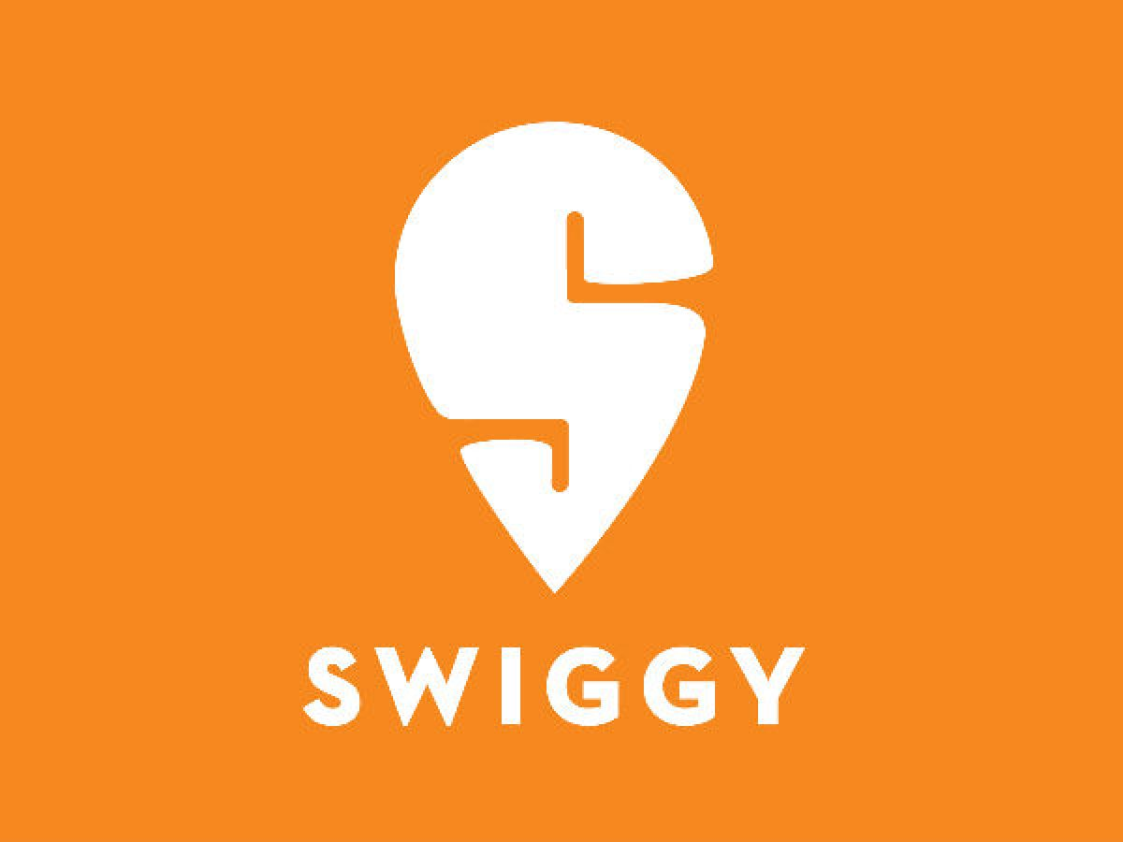
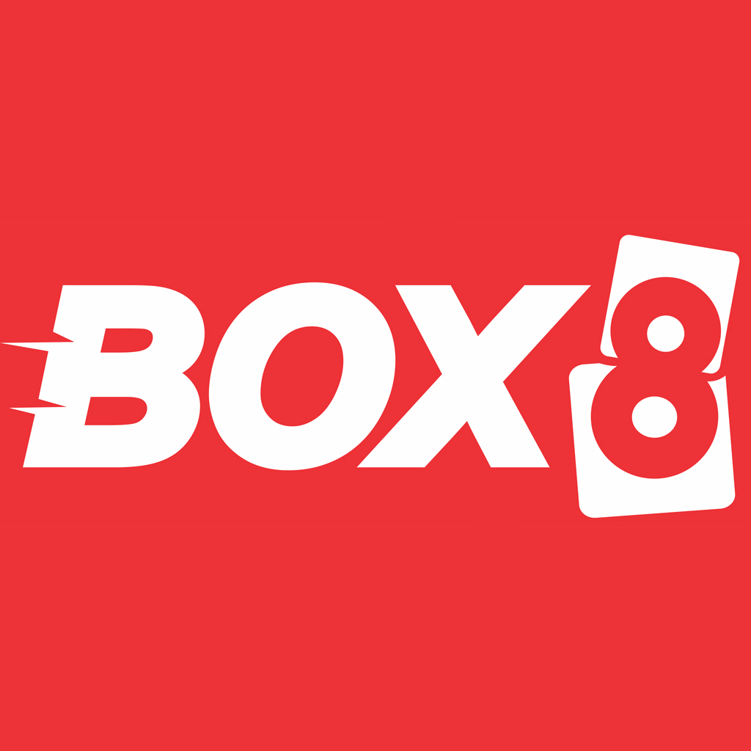
Competitor Analysis
Market Leaders
Zomato
Swiggy
FreshMenu
BOX8
Faasos
EatSure
Direct Competitors
Zomato
Swiggy
Indirect Competitors
Restaurants with delivery options
Dunzo
Notes:
© Copyright UpGrad Education Pvt. Ltd. All rights reserved

Slide 17
Competitor Analysis
Background of Swiggy
Introduction: Swiggy is an on-demand food delivery platform that brings food from neighbourhood restaurants directly to customers' doors.
The company's food delivery platform lists local restaurants and menu lists on an app for users to order from and track the delivery of its delivery executives, enabling users to order food with speed and convenience. Its service is used to pick up and drop off a diverse array of items, including laundry and document or parcel deliveries to business clients and retail customers.
Founders: Swiggy was founded by Sri Harsha Majety, Nandan Reddy, and Rahul Jaiminiin in 2014 and is headquartered in Bangalore, Karnataka, India.
1. Sri Harsha Majety, CEO and Co-Founder: Sriharsha Majeti has a bachelor’s degree in BE electrical and electronics. He has also been an alumnus of Birla Institute of Technology and Science (BITS), Pilani with an MSc degree in physics. Harsha has previously been an associate at Nomura International which is a financial service provider and a global investment bank headquartered in London, UK.
The Swiggy co-founder and CEO came back to India from London and started his own entrepreneurial venture, Bundl which aimed at providing shipping solutions to e-commerce merchants alongside Nandan Reddy who is also presently a co-founder at Swiggy.
2. Nandan Reddy Co-Founder: Nandan Reddy has also completed his education from BITS, Pilani. He has previously been known to build a start-up based on Point-of-Sale tablet software for restaurants. Reddy has been a core member of management at Source Pilani that was known as India’s first non-urban Business Process Outsourcing (BPO). Later on in life, he co-founded Bundl along with his BITS, Pilani mate, Harsha
Notes:
© Copyright UpGrad Education Pvt. Ltd. All rights reserved

Slide 18
Competitor Analysis
3. Rahul Jaimini, Co-Founder: Rahul Jaimmini completed his education from IIT-Kharagpur and then went off to intern at Phillips Research and Virginia Technologies. He has also previously worked for almost two years at NetApp after which he moved on to e-commerce giant, Myntra. Rahul was working as a senior software engineer at Myntra and was responsible for revenue impactful assignments and fast design. Later, in 2014, he ended up co-founding Swiggy along with the other two founders.
Recently, Rahul Jaimini has quit Swiggy and joined Pesto Tech as a co-founder which is a career accelerator start-up. He is no longer a part of the day-to-day operations at Swiggy but remains a board member and shareholder in the food delivering company.
Goal: Their stated objective is to revolutionize the restaurant-takeaway-delivery business in India which is fraught with problems both on the consumer as well as the restaurant end
Mission: Swiggy’s mission is to change the way India eats
Vision: Swiggy's vision is to elevate the quality of life of urban consumers by offering unparalleled convenience
Tagline: Swiggy karo, phir jo chahe Karo!
Investment: Swiggy is funded by 23 investors. Carmignac and Falcon Edge Capital are the most recent investors
> 2021: Swiggy raised $800 million in its latest Series J round of financing with Falcon Edge Capital, Amansa Capital, Think
Investments, Carmignac and Goldman Sachs which has raised Swiggy’s valuation to more than $4.9 billion
> 2020: Swiggy received around USD 43 Mn funding which valued the company at USD 3.6 Bn
> 2018: Swiggy also received USD 100 Mn from China-based Meituan-Dianping and Naspers and then later a string of
investments took the company's valuation to over a USD 1 Bn
Notes:
© Copyright UpGrad Education Pvt. Ltd. All rights reserved

Slide 19
Competitor Analysis
> 2017: Naspers led an USD 80 million funding round
> 2016: Raised USD15 Mn from new and existing investors, including Bessemer Venture Partners and Harmony Partners
> 2015: USD 2 Mn investment from Accel and SAIF Partners , along with an additional investment from Norwest Venture Partners
Acquisitions and Partnerships: Swiggy has acquired 4 organizations. Their most recent acquisition was Kint.io on Feb 4, 2019
> Swiggy acquired Bangalore-based Asian food start-up 48East in 2017.
> Swiggy later acquired Mumbai-based Scootsy Logistics, a struggling food and fashion delivery service. It also acquired a milk
delivery start-up in Mumbai called SuprDaily in an all-cash deal.
> In 2019, the company invested Rs 31 crore in Mumbai-based ready-to-eat food brand Fingerlix.
> Swiggy plans to transition Scootsy’s partners, fleet and nudge consumers to its app and shut Scootsy by June-end 2020
> Swiggy has partnered with Burger King for providing delivery services. It has also partnered with Google Local Guide to facilitate
customer reviews and with Sodexo to enable customers for paying through meal cards.
> Swiggy has partnered with Indifi Technologies to facilitate a financing program for partner restaurants.
Notes:
© Copyright UpGrad Education Pvt. Ltd. All rights reserved

Slide 20
Competitor Analysis
Background of Zomato
Introduction: Founded in 2008, Zomato is a leading platform for restaurant search & discovery, online food ordering, and restaurant table reservations.
Featuring a robust review system, Zomato allows foodies to find the best meals and restaurants in their neighborhood. A notable aspect about Zomato is that it is among the few companies that have gone global after starting operations in India. Zomato currently operates in more than 24 countries. Initially, it started under the name Foodiebay which was later changed into Zomato in the year 2010.
Founders: The company was founded by Deepinder Goyal and Pankaj Chaddah and is headquartered in Gurgaon.
1. Deepinder Goyal, CEO and Co-Founder: Prior to starting Zomato, Deepinder worked as a management consultant with Bain and Company in New Delhi. It was at Bain that Deepinder conceived the idea of an online restaurant information service after seeing the demand for menu cards among his colleagues. He left Bain in 2008 to start Zomato (then foodiebay) out of his apartment and has since overseen strategy and product development. Deepinder graduated with a Mathematics and Computing degree from IIT Delhi in 2005.
2. Pankaj Chaddah, COO and Co-Founder: Prior to Zomato, Pankaj worked with Bain and Company, in New Delhi. In his current role, Pankaj oversees sales and operations for Zomato in local and international markets. He has also been responsible for all mobile development and distribution across platforms. Pankaj graduated with a degree in mechanical engineering from IIT Delhi in 2007.
Notes:
© Copyright UpGrad Education Pvt. Ltd. All rights reserved

Slide 21
Competitor Analysis
Goal: Connecting customers to restaurants is Zomato’s main goal. They work to ensure customers have the best experience at any restaurant found on their platform
Mission: Zomato’s mission is to ensure nobody has a bad meal
Vision: Zomato want to be the ‘Google’ of food. Their vision is to be the global platform when someone is looking for food locally
Tagline: Discover great places to eat around you
Investment: Zomato is funded by 25 investors. Fidelity Management and Research Company and Tiger Global Management are the most recent investors
> 2021: Zomato has raised $250 million, two months after closing a $660 million Series J financing round, as the Indian food
delivery startup builds a war-chest ahead of its IPO later this year. The new investment gives Zomato a post-money
valuation of $5.4 billion, up from $3.9 billion in December last year, said Info Edge, which owns 18.4% stake in the Indian
startup
> 2020: As part of a Series J round of funding, Zomato raised $52 million from Kora, a US-based Investment firm
> 2020: Zomato raised $62 million from Temasek, after previously committed capitol from Ant Financial never came through
> 2018: Zomato raised USD 210 Million from Alibaba's payment affiliate Ant Financial
> 2015: Info Edge India, Vy Capital and Sequoia Capital led another round of funding for US$50 million.^{[42]} This was followed by.
another US$60 million funding led by Temasek, a Singapore government-owned investment company, along with Vy
Capital in September
Notes:
© Copyright UpGrad Education Pvt. Ltd. All rights reserved

Slide 22
Competitor Analysis
> 2014 : Zomato completed another round of funding of US$60 million at a post-money valuation of ~US$660 million.^{[40]} This
round of funding was being led jointly by Info Edge India and Vy Capital, with participation from Sequoia Capital
> 2010-13: Zomato raised approximately US$16.7 million from Info Edge India, giving Info Edge India a 57.9% stake in Zomato. In November 2013, it raised an additional US$37 million from Sequoia Capital and Info Edge India
Acquisitions and Partnerships: Zomato has acquired 14 organizations. Their most recent acquisition was FITSO on Jan 20, 2021. They acquired FITSO for ₹1B.
> Zomato has acquired 12 startups globally. In July 2014 Zomato acquired the startup Menu Menia.
> Zomato acquired Sparse Labs, which is a logistics technology-based star-up in 2016 to get a hands-on team focusing on the
improvement of the delivery experience of Zomato customers.
> Zomato acquired Tongue stun in September 2018, a Bengaluru startup, for cash and stock deal of 18 million dollars.
> Zomato also acquired a Tech Angle startup in Lucknow that worked on drones.
> Zomato acquired stocks of UberEats for a deal value of 350 million dollars on 21st January 2020.
> Indian foodtech unicorn Zomato has acquired full-stack sports facilities provider and discovery startup Fitso in a deal reportedly
worth INR 80 Cr-INR 100 Cr.
> It was announced in July 2014 that Zomato has acquired MenuMania for an undisclosed sum. The acquisition was planned to
make Zomato and MenuMania, together, the largest restaurant information provider in New Zealand.
> A Poland based restaurant; it was acquired in September 2014. Gastronauci has been active in Poland since 2007 and was
proud to be a partner of Zomato from 2014 onwards.
> Another global acquisition, this time around towards the end of 2014, Zomato targeted an Italian restaurant search service
‘Cibando’. This was a part of Zomato’s initiative to expand to Italy, investing around $6 million in the region.
Notes:
© Copyright UpGrad Education Pvt. Ltd. All rights reserved

Slide 23
Competitor Analysis
Specifics | Swiggy | Zomato
No. of employees | 13001+ | 10001+
No. of investors | 23 | 25
No. of funding rounds | 13 | 21
Total funding amount | $2.4 Billion | $2.1 Billion
Acquisitions | 4 | 14
Website visits(in April) | 8.15 Million | 18.53 Million
Parent Company | Bundl Technologies Private Limited | In IPO Registration
Notes:
© Copyright UpGrad Education Pvt. Ltd. All rights reserved

Slide 24
Competitor Analysis
Business Analysis
Swiggy
Swiggy's main target audience is the 18-35 demographic, which has easy access to a smartphone, is fluent with using apps to get services and looks towards online platforms to fulfil their daily necessities
Average order value of Swiggy is Rs.340 – Rs.370
Average order frequency of Swiggy is 1.4 million food orders daily across India(in 2019)
For the fiscal year ended March 31, 2020 (FY20), Swiggy has reported total income of INR 2,956 Cr. Swiggy’s revenue grew 129% year-on-year (YoY) from INR 1,292 Cr in FY19. The company’s losses grew 66% from INR 2,362 Cr in FY19 to INR 3,909 Cr in FY20
Zomato
Zomato targets people of the age group of 18-35 years who are comfortable using smartphones. The people of this age group are tech-savvy and can use mobile applications. The target audience of Zomato is of 2 categories: (a) Customers who want to dine out, (b) Customers who are ordering food online
Average order value of Zomato is Rs.380 – Rs.410
Average order frequency of Zomato is 1.1 million food orders daily across India(in 2020)
Zomato, in its latest filings, also highlighted that its revenue increased by a whopping 96%, from INR 1,398 Cr in FY19 to INR 2,743 Cr in FY20. The company’s losses increased by 133% or 2.3x to INR 2,363 Cr from the previously reported INR 1,013 Cr
Notes:
© Copyright UpGrad Education Pvt. Ltd. All rights reserved

Slide 25
Competitor Analysis
Notes:
© Copyright UpGrad Education Pvt. Ltd. All rights reserved

Slide 26
Competitor Analysis
Value Added Services
Swiggy
Swiggy has no minimum order requirement for delivery which is why it often receives orders amounted to less than Rs. 100. It is the reason for Swiggy scaling up to 14 million orders per month
Swiggy Stores deliver groceries, flowers, medicines, and other things to the doorstep of its customers within an hour
Genie – It offers instant pick & drop services used by customers to send packages, lunch boxes to their kids, documents to the office, and parcels anywhere across the city. Also, customers can use Swiggy Go services to drop laundry or fetch forgotten keys
Zomato
Zomato is wholly dedicated to nurturing a neutral platform. It consistently aids food establishments in maintaining high standards through Hyperpure. Hyperpure is an innovative initiative by Zomato to bring fresh, squeaky clean, and high-quality ingredients and kitchen supplies to its partner restaurants. Food Hygiene rating is the most yearned for a symbol of quality well known among its partner restaurants
They offer table reservations, perform corporate catering, and feed India
The success of Zomato gold speaks volumes for Zomato’s efficiency in providing an array of exciting choices. Zomato continually strives and leaves no stone unturned in delivering the best. They ensure affordability without compromising on their profits
Notes:
© Copyright UpGrad Education Pvt. Ltd. All rights reserved

Slide 27
Competitor Analysis
Shifts in Business Model(Swiggy)
Swiggy Super: Swiggy launched a membership program called `Swiggy Super’ for customers. This program offers unlimited free delivery on all orders above ₹149. After subscribing to this program, customers don’t have to pay surge pricing during excessive demands.
Swiggy Go: Another revenue stream for Swiggy is a concierge service Swiggy Go that was launched in 2019 to offer instant pick & drop service.
Through Swiggy Go, the company earns by helping customers to send, pick, and drop anything to and from different locations
anywhere across the city.
Notes:
© Copyright UpGrad Education Pvt. Ltd. All rights reserved

Slide 28
Competitor Analysis
Strengths and Weaknesses
About | Swiggy | Zomato
Strengths | It offers multiple services to its users like ordering food, shopping grocery through Instamart and recently launched Swiggy Genie which helps Swiggy to capture a larger market Refund policy is very quick and fast It delivers food to its customers with a neat pack It has better customer support | It gives the option to view restaurants pictures, menus and map locations It gives the option to bookmark a restaurant and share the details History option is upfront for those who like to repeat the orders/restaurants
Weaknesses | It has delivery charges, if the order does not fulfill the minimum price criteria (i.e. below 150 or depending upon the places) which is one of the biggest turn off for the users Difference in prices between swiggy menu and walking menu provided by the restaurants No transparency regarding how the restaurants look like, cleanliness and hygiene of the kitchen Lack of information is provided in terms of dishes | Offers are not directly visible on the menu page Inadequate contents on the app Unsupported customer service
Notes:
© Copyright UpGrad Education Pvt. Ltd. All rights reserved

Slide 29
Competitor Analysis
Pain Points
Swiggy
Instructions comment sections have always been neglected. Vendors rarely pay any attention if a customer has specified instructions..
Frequent surge in pricing and minimum order value.
Several incidents happen when the wrong food gets delivered.
Suddenly restaurants become unserviceable after clicking on proceed to pay
Zomato
Online payment methods are not that good. Most of the time the payment process gets stuck in the middle and the amount will get deducted from the account. And in the app, it will show payment failed.
Few menus are outdated i.e., the price has increased.
It manipulates the delivery timing. Before placing an order, delivery time will show 20 mins and after placing an order delivery timing keeps on changing
Notes:
© Copyright UpGrad Education Pvt. Ltd. All rights reserved

Slide 30
Competitor Analysis
Product Analysis of Swiggy and Zomato
Specifics | Swiggy | Zomato
Services | Food delivery, Instamart, Genie, Gourmet and Organic Stores | Food delivery, Pre-Booking at restaurants, Special discount at restaurants for premium members
Category Rank | 1 | 3
App Installs | 50M+(across all platforms) | 100M+(across all platforms)
App Ratings | 4.1 with 2M+ reviews (Play store), 4.3 with 420.5K Ratings (App Store) | 4.1 with 4.8M+ reviews (Play store), 4.6 with 1.7M Ratings (App Store)
Bounce Rate | 32.62% | 52.62%
Traffic Sources | Direct(71.72%), Referrals(0.81%), Search(25.59%), Social(1.22%), Mail(0.49%), and Display(0.17%) | Direct(33.59%), Referrals(1.06%), Search(64.09%), Social(0.78%), Mail(0.45%), and Display(0.02%)
Notes:
© Copyright UpGrad Education Pvt. Ltd. All rights reserved

Slide 31
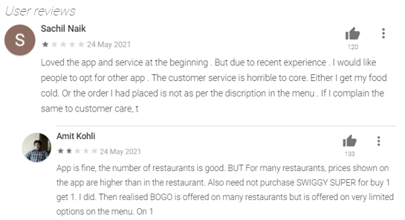
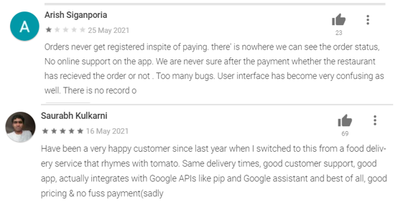
Competitor Analysis
User Experience and User Reviews Swiggy
Overall Functionality and User Experience for Swiggy
With the new design the home looks more cluttered as there is no free space and lot of options to select which can be confusing.
But we still can dive right in and place an order, but the blue screen stands out and warns us to select our location first.
Smart use of restaurants we probably might reorder from and the recent search feature is helpful.
Diverse option to make payment and recommends payment methods.
All in all the app’s look and feel is good and the minimalistic design in good for user experience.
Recent User Feedback for the app
Notes:
© Copyright UpGrad Education Pvt. Ltd. All rights reserved

Slide 32
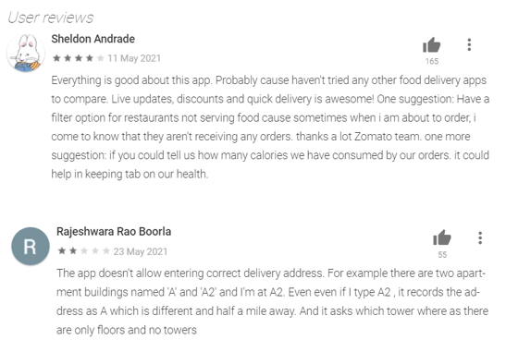
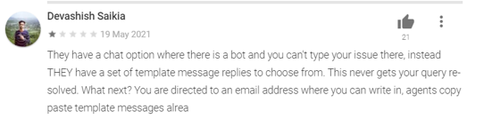
Competitor Analysis
User Experience and User Reviews Zomato
Overall Functionality and User Experience for Zomato
Zomato has always been experimenting with their design system and keeps refreshing it from time to time.
The new design system keeps the user at the center of everything and focuses on simplicity.
By following the atomic design methodology, all the small parts have been paid attention to and feel part of the same family.
The Interface and especially the User Experience of the app are simple and clutter-free.
Recent User Feedback for the app
Notes:
© Copyright UpGrad Education Pvt. Ltd. All rights reserved

Slide 33
Competitor Analysis
Future Initiatives(Swiggy)
Swiggy is planning to be a super app in upcoming years. A typical super app in the delivery and commerce space offers everything from food delivery, ride-sharing, movie and travel ticketing, home services, payments, lifestyle services and more.
Swiggy has ventured into different hyperlocal categories in a bid to get dormant customers back and give them more reasons to use the app, as food delivery volumes continue to be impacted from the ongoing pandemic. Typically speaking, in the hyperlocal deliveries' ecosystem, any store within the hyperlocal geography eventually becomes a point of supply for the platform.
Swiggy is taking the ‘super app’ model, borrowed from apps like Gojek, Postmates, Grab and Instacart. Built on top of highly efficient last-mile logistics operations, food delivery is just one of the categories in a super app. This model has seen some success globally in Southeast Asia and the US, but Swiggy is not exactly going by the template set by Gojek and the likes.
Notes:
© Copyright UpGrad Education Pvt. Ltd. All rights reserved

Slide 34
Competitor Analysis
Future Initiatives(Zomato)
In FY20, Zomato’s primary revenue source included ad sales, food delivery, ordering and Zomato Pro subscriptions. For its next leg of growth, Zomato is now doubling down as a direct service provider for restaurants by offering online discovery, tablebooking, cloud kitchen infrastructure and B2B raw material supply for restaurants.
In FY20, the company’s B2B restaurant supplies subsidiary ‘Hyperpure’ recorded eightfold growth in revenue which grew from $1.8 Mn in FY19 to $14.7 Mn in FY20. At present, more than 2,280 restaurants use Hyperpure, Zomato claims. Hyperpure not only allows Zomato to better forecast demand and therefore source raw materials such as grains, fruits, and vegetables on a larger scale, but it’s also an upsell to its restaurant partners — part of the bundle of services aligned with food delivery.
Zomato has even indicated the desire to enter food-adjacent categories such as grocery — which it eventually shelved — and now nutraceuticals and health supplements.
Zomato is approaching a full-stack approach, for example A large restaurant will eventually want to have its supply chain for sourcing fresh raw materials. And even if B2B startups want to cater to big restaurants you are talking about setting up a massive supply chain and logistics on top of perishable goods. This is a tough business unless you are narrowly focusing on certain raw material SKUs only. Zomato may have to elevate its operations to near ecommerce level of complexity to have wide coverage.
Notes:
© Copyright UpGrad Education Pvt. Ltd. All rights reserved

Slide 35
Competitor Analysis
References
https://www.swiggy.com/
https://www.zomato.com/
https://www.crunchbase.com/
https://craft.co/
https://www.similarweb.com/
https://www.livemint.com/companies/start-ups/swiggy-eyes-100-mn-customers-using-the-app-over-15-times-a-month-in-10-15-years-11571422800906.html
https://inc42.com/buzz/swiggy-outpaces-zomato-in-revenue-race-despite-66-higher-losses/
https://en.wikipedia.org/wiki/Swiggy
https://en.wikipedia.org/wiki/Zomato
https://economictimes.indiatimes.com/tech/startups/zomatos-revenue-nearly-doubles-loss-widens-160-in-2019-20/articleshow/80099897.cms?from=mdr
https://medium.com/
Notes:
© Copyright UpGrad Education Pvt. Ltd. All rights reserved

Slide 36
Part 2: User Research
Notes:
© Copyright UpGrad Education Pvt. Ltd. All rights reserved

Slide 37
Objectives and Hypotheses
Objective:
The objective of this survey is to analyze the preferences of ordering food online and the key motivations of users to order food online that are coming from different geographies and age groups.
Hypotheses:
Single people would prefer to order food online more frequently.
Even if people cook food at home they order at least once in a week.
People check reviews and ratings before ordering.
People prefer to order food from a restaurant where you are getting an offer/discount.
People who have hired a cook tend to order food less through online.
Frequent users would prefer to try experiment with new restaurants.
Frequent users would prefer to buy a membership plan to get additional benefits/discounts.
People don’t want to compromise with hygiene and quality of food.
People would prefer quality over quantity.
Most of the people have bad experience due to delayed delivery.
Most people are influenced by promotions on social media platforms.
People earning more than 11 lacs spend more on ordering food online.
People feel ordering the food online is worth the price.
Notes:
© Copyright UpGrad Education Pvt. Ltd. All rights reserved

Slide 38
Surveys
Survey Link :- https://forms.gle/KjbD6SKrQfkxiRA97
Response Link:-
https://docs.google.com/forms/d/1JtgTTRWgTOxVx7Pjm7sZl8BBPoIgAwrFM3_6WY85gKo/edit?usp=sharing
Notes:
© Copyright UpGrad Education Pvt. Ltd. All rights reserved

Slide 39
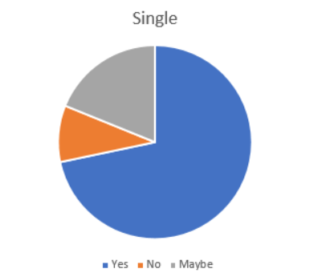
Surveys Insights-Hypothesis 1
Hypothesis 1: Single people would prefer to order food online more frequently.
As per the pie chart around 72% of single individuals preferred ordering food online. Whereas 19% are uncertain about it and 9% wouldn’t prefer to order food online. The majority of the single audience would prefer ordering food online so this verifies the hypothesis 1 to be true.
 | Yes | No | Maybe
Single | 38 | 5 | 10
Notes:
© Copyright UpGrad Education Pvt. Ltd. All rights reserved

Slide 40
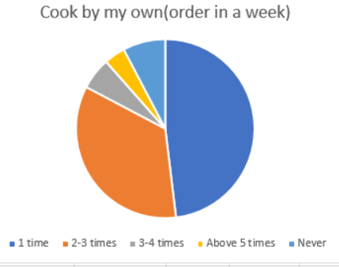
Surveys Insights-Hypothesis 2
Hypothesis 2: Even if people cook food at home they order at least once in a week.
As per the survey responses, people who cook food by themselves also order food online at least once in a week.
48% order at least once,35% order 2-3 times in a week and around 6% percent of the audience order food 3-4 times and 4% prefer to order more than 5 times in a week. Only 8% of the responses would never order food online.
As per the statistics majority of the people who cook food at by own still prefer to order food online at least once in a week. So, this proves the hypothesis 2 to be true.
 | 1 time | 2-3 times | 3-4 times | Above 5 times | Never
Cook by my own(order in a week) | 25 | 18 | 3 | 2 | 4
Notes:
© Copyright UpGrad Education Pvt. Ltd. All rights reserved

Slide 41
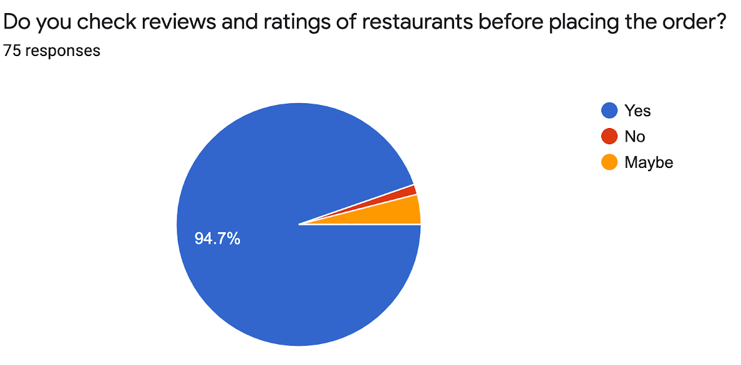
Surveys Insights-Hypothesis 3
Hypothesis 3: People check reviews and ratings before ordering.
As per the survey responses around 94.7% of the audience would prefer to check reviews and rating of restaurants before placing orders and 4% are unsure about it. Only one 1% of the surveyed audience would not check reviews and ratings before ordering food online.
So, this validates hypothesis 3 .
Notes:
© Copyright UpGrad Education Pvt. Ltd. All rights reserved

Slide 42
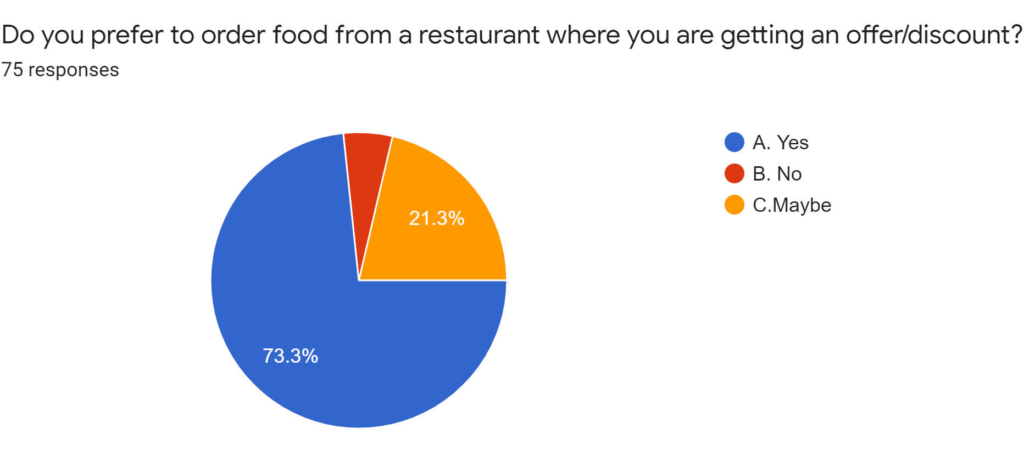
Surveys Insights-Hypothesis 4
Hypothesis 4: People prefer to order food from a restaurant where you are getting an offer/discount.
As per the survey responses, around 73.3% of the surveyed audience would prefer to order from the restaurants where they get offers and discounts.
Around 21.3% of audience is uncertain about it and only 5.3% of the surveyed audience wouldn’t order from the restaurants where they get offers and discounts.
So this validates the hypothesis 4.
Notes:
© Copyright UpGrad Education Pvt. Ltd. All rights reserved

Slide 43
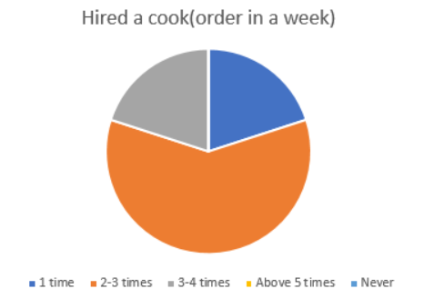
Surveys Insights-Hypothesis 5
Hypothesis 5: People who have hired a cook tend to order food less through online.
As per the survey responses, people who hired
20% order at least once,60% order 2-3 times in a week and around 20% percent of the audience order food 3-4 times and none prefer to order more than 5 times in a week.
So, as data shows people who hired cook tend to order food online but at lesser frequency as compared those who cook by themselves.This validates the hypothesis 5.
 | 1 time | 2-3 times | 3-4 times | Above 5 times | Never
Hired a cook (order in a week) | 2 | 6 | 2 | 0 | 0
Notes:
© Copyright UpGrad Education Pvt. Ltd. All rights reserved

Slide 44
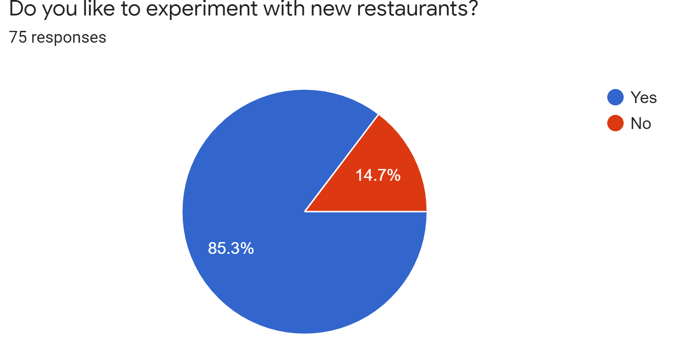
Surveys Insights-Hypothesis 6
Hypothesis 6: Frequent users would prefer to try experiment with new restaurants.
As per the survey responses around 85.3% of the audience would prefer to experiment with new restaurants and 14.7% of the surveyed audience wouldn't prefer to experiment with restaurants while ordering food online.
As majority of the surveyed audience would prefer to experiment with new restaurants.
This verifies the hypothesis 6 to be true.
Notes:
© Copyright UpGrad Education Pvt. Ltd. All rights reserved

Slide 45
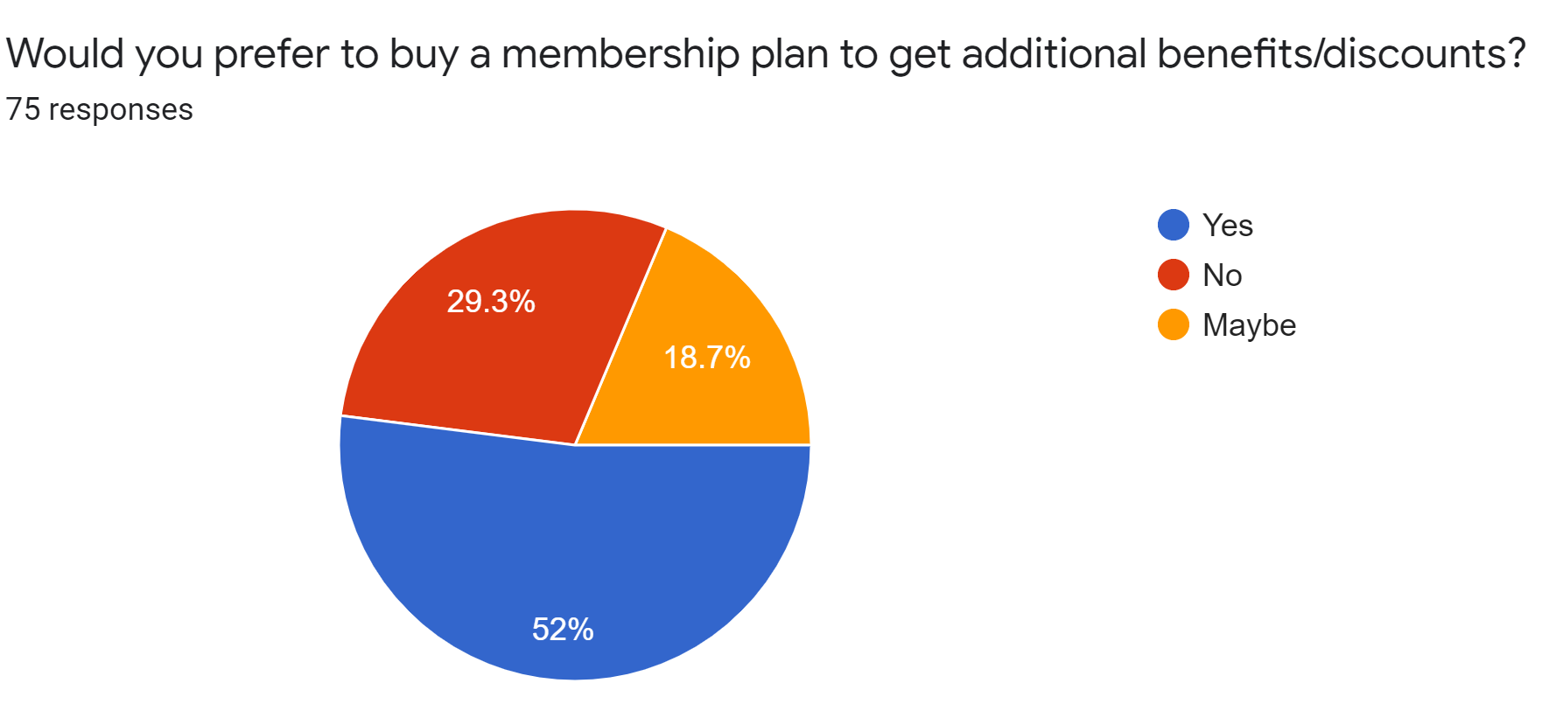
Surveys Insights-Hypothesis 7
Hypothesis 7: Frequent users would prefer to buy a membership plan to get additional benefits/discounts.
As per the survey responses around 52% of the audience would prefer to buy membership plans to get additional benefits/discounts where as 18.7% are uncertain about it. 29.3% wouldn’t prefer to buy a membership plan.
As majority of the surveyed audience would prefer to buy membership plans to get additional benefits/discounts.
This validates hypothesis 7 .
Notes:
© Copyright UpGrad Education Pvt. Ltd. All rights reserved

Slide 46
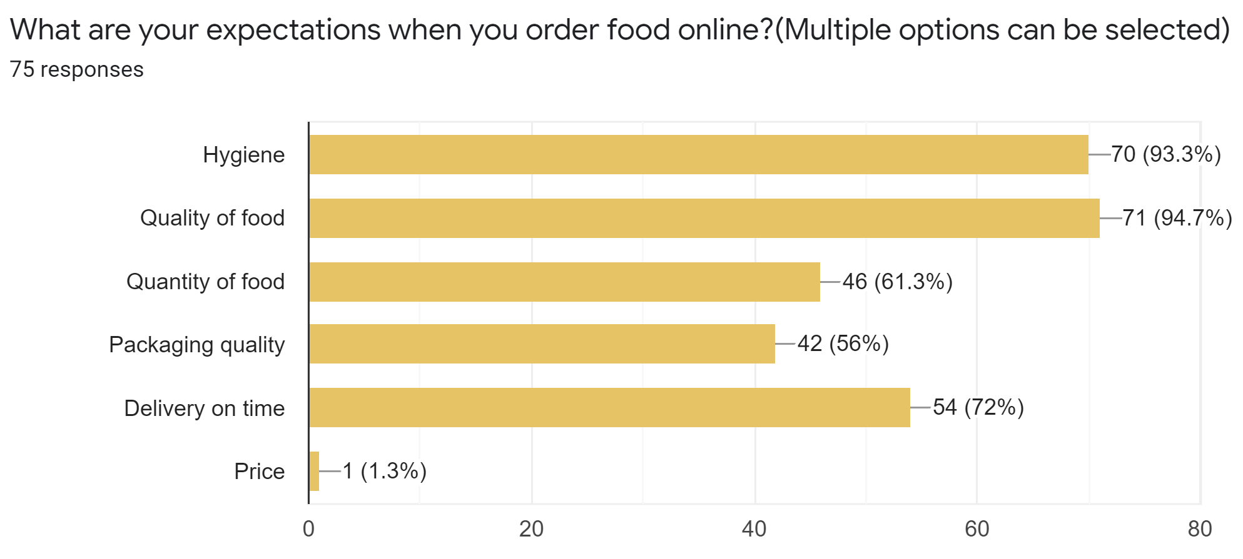
Surveys Insights--Hypothesis 8 & 9
Hypothesis 8: People don’t want to compromise with hygiene and quality of food.
Hypothesis 9: People would prefer quality over quantity.
As per the survey responses people voted hygiene and quality the highest that is around 93 to 94% over other expectations. This proves people won't compromise with hygiene and quality of food. This validates hypothesis 8.
61.3% of the surveyed audience voted for quantity but 94.7% audience voted for quality. That means people would prefer quality over quantity. This validates hypothesis 9.
Notes:
© Copyright UpGrad Education Pvt. Ltd. All rights reserved

Slide 47
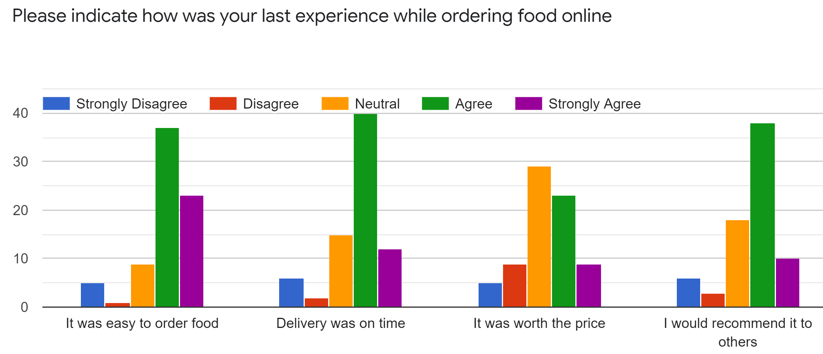
Surveys Insights-Hypothesis 10
Hypothesis 10: Most of the people expect to get delivery on time.
As per the survey responses people agree that on time delivery would make their experience better. So this validates the hypothesis 10.
Notes:
© Copyright UpGrad Education Pvt. Ltd. All rights reserved

Slide 48
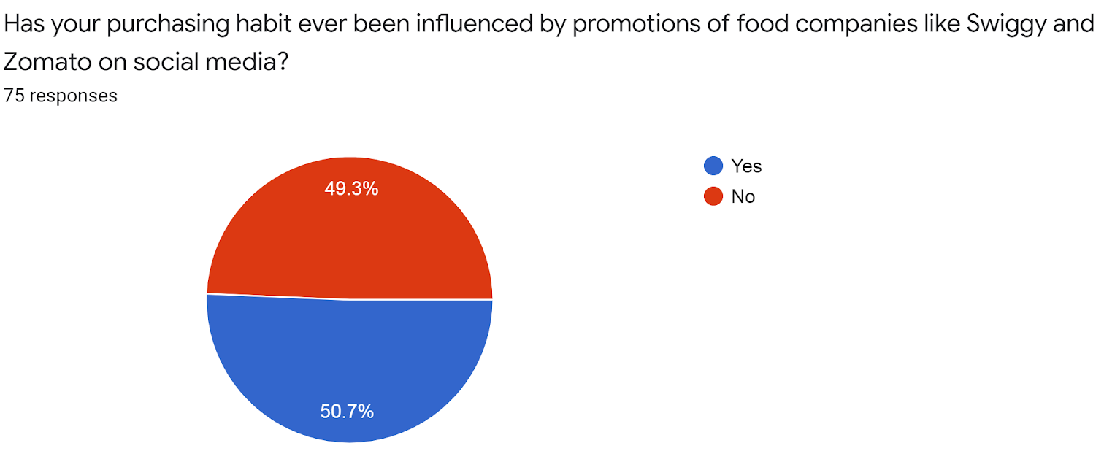
Surveys Insights-Hypothesis 11
Hypothesis 11: Most people are influenced by promotions on social media platforms.
Around 50.7% of the surveyed audience said they are influenced by social media platforms where as 49.3% of didn't agree with the same. As the difference between them is small. This would verify hypothesis 11 partially correct.
Notes:
© Copyright UpGrad Education Pvt. Ltd. All rights reserved

Slide 49
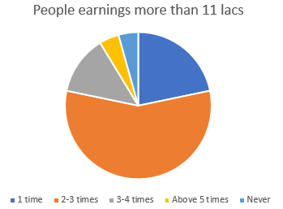
Surveys Insights-Hypothesis 12
Hypothesis 12: People earning more than 11 LPA spend more on ordering food online.
The pie chart represents the responses of survey of people earning more than 11 LPA.Around 57% said they order food once a week and 22% said that they order food 2-3 times week and 13% order 3-4 times.
Only 4% said they order more than 5 times in a week and 4% said they never order food online.
So the percentage of people ordering food online for 1-3 times is higher but its relatively lower for 3-5 times.
So this would make the hypothesis 12 only partially correct.
 | 1 time | 2-3 times | 3-4 times | Above 5 times | Never
People earning more than 11 LPA | 5 | 13 | 3 | 1 | 1
Notes:
© Copyright UpGrad Education Pvt. Ltd. All rights reserved

Slide 50
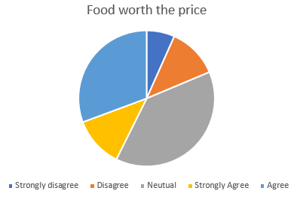
Surveys Insights-Hypothesis 13
Hypothesis 13: People feel ordering the food online is worth the price.
Around 12% of the survey audience strongly agree that ordering food online is worth the price and 31 % agree with it as well.39% are neutral about the experience.
Whereas only 7% strongly disagree and 12% disagree with it.
So, looking at statistics more than 80% of audience is either neutral or agree that ordering food online is worth the price.
This validates hypothesis 13.
 | Strongly disagree | Disagree | Neutral | Strongly agree | Agree
Food worth the price | 5 | 9 | 29 | 9 | 23
Notes:
© Copyright UpGrad Education Pvt. Ltd. All rights reserved

Slide 51
Interviews
Questions
Where are you from?
How long have you been here? NOTE: Ask this question if the person is not staying in his/her hometown
Do you stay alone or with Friends or Family?
What do you do for food?
What time does your cook come? NOTE: Ask this question if a person has cook coming
Why do you want a cook?
Do you order food online?
How do you order food? NOTE: If ordering food
Do you order from the same restaurants everytime or do you try new ones?
What are your food choices?
Which cuisine do you prefer the most?
Would you prefer to have home cooked food everyday from the same place?
What are your expectations while ordering food online?
Do you prefer ordering food from a mobile app or website?
What are the top 5 apps you use in your daily life?
What internet access options do you have?
Are you an android, iOS, or windows user?
Any suggestions or feedback to make your experience more seamless?
Notes:
© Copyright UpGrad Education Pvt. Ltd. All rights reserved

Slide 52
Interviews Insights
Hypotheses:
Even if people cook food at home they order at least once in a week.
5 out of 10 interviewed people said they cook food at home. 4 said they order food online once or twice a week whereas one said they order more than 5 times a week.
But all said they order food at least once a week this validates this hypothesis.
People prefer reviews and ratings before ordering.
9 out of 10 interviewed audience said they do prefer to check restaurant ratings and reviews before they order food online. This validates this hypothesis to be true.
People prefer to order home cooked food from the same place.
4 out of 10 interviewed audience said they would prefer to order home cooked food from same place whereas 6 out of 10 disagreed with it. The majority of interviewed audience wouldn't prefer to order home cooked food from same place. So, this invalidates this hypothesis.
People would prefer to try experiment with new restaurants.
8 out of 10 interviewed people said they would prefer to experiment with new restaurants.
Only 2 out of 10 said they wouldn't prefer to experiment with new restaurants. The majority of audience would prefer to experiment with new restaurants. This validates hypothesis to be true.
Most of the people prefer Indian cuisine over others.
9 out of 10 interviewed audience prefer to order Indian cuisine over others.
Majority would prefer to order Indian cuisines online. This validates this hypothesis to be true.
Notes:
© Copyright UpGrad Education Pvt. Ltd. All rights reserved

Slide 53
Part 3: Business Model Canvas
Notes:
© Copyright UpGrad Education Pvt. Ltd. All rights reserved

Slide 54
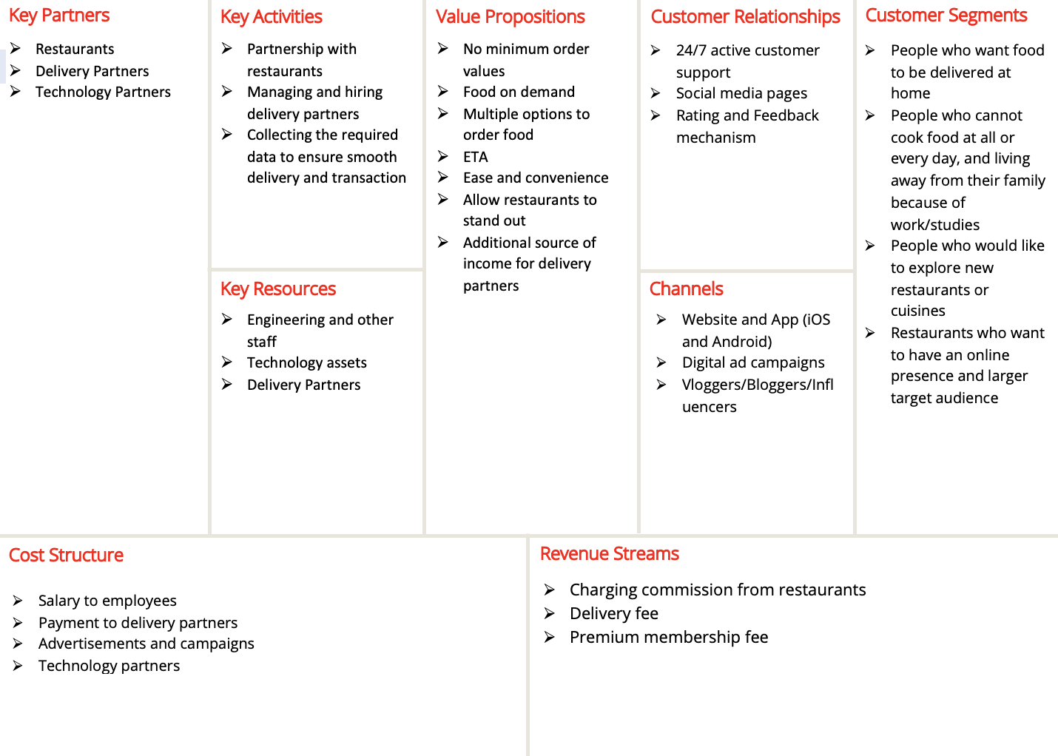
Business Model Analysis
Notes:
© Copyright UpGrad Education Pvt. Ltd. All rights reserved

Slide 55
Part 4: Product Artefacts
Notes:
© Copyright UpGrad Education Pvt. Ltd. All rights reserved

Slide 56
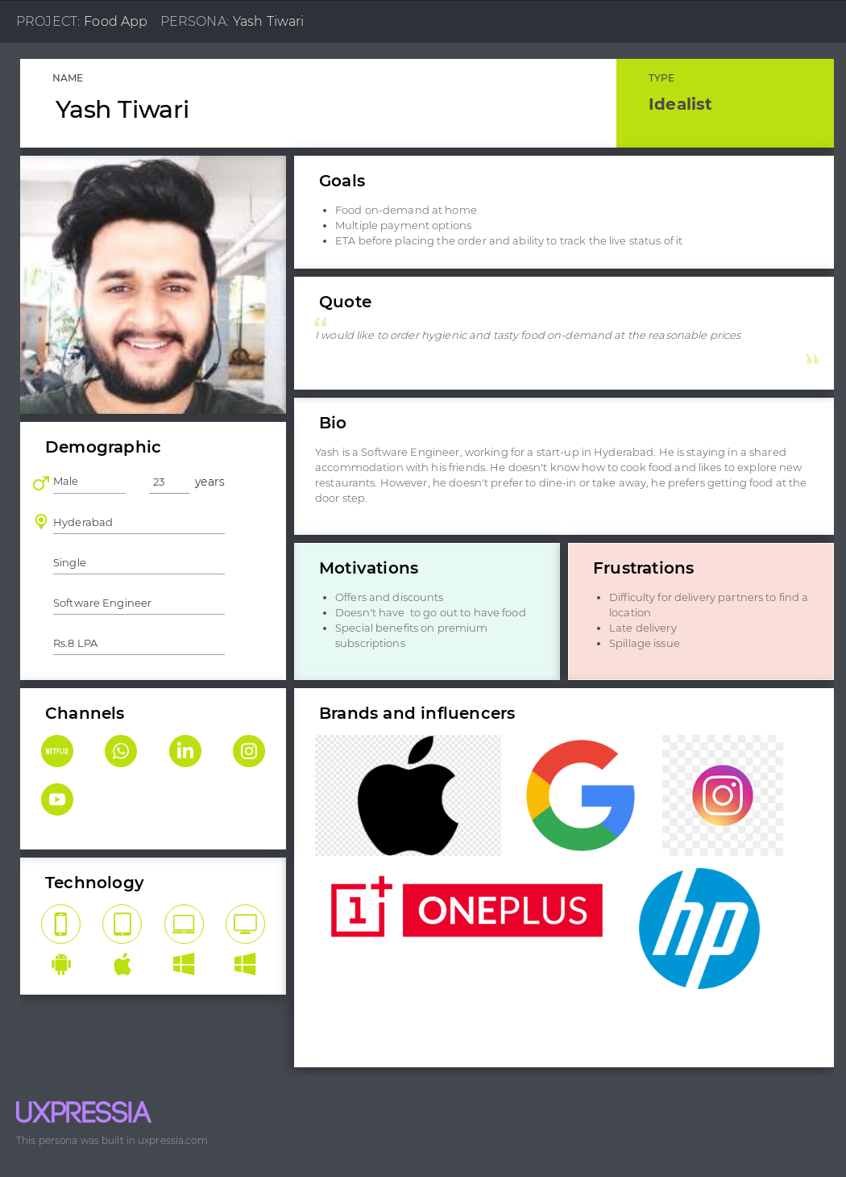
User Persona
Notes:
© Copyright UpGrad Education Pvt. Ltd. All rights reserved

Slide 57
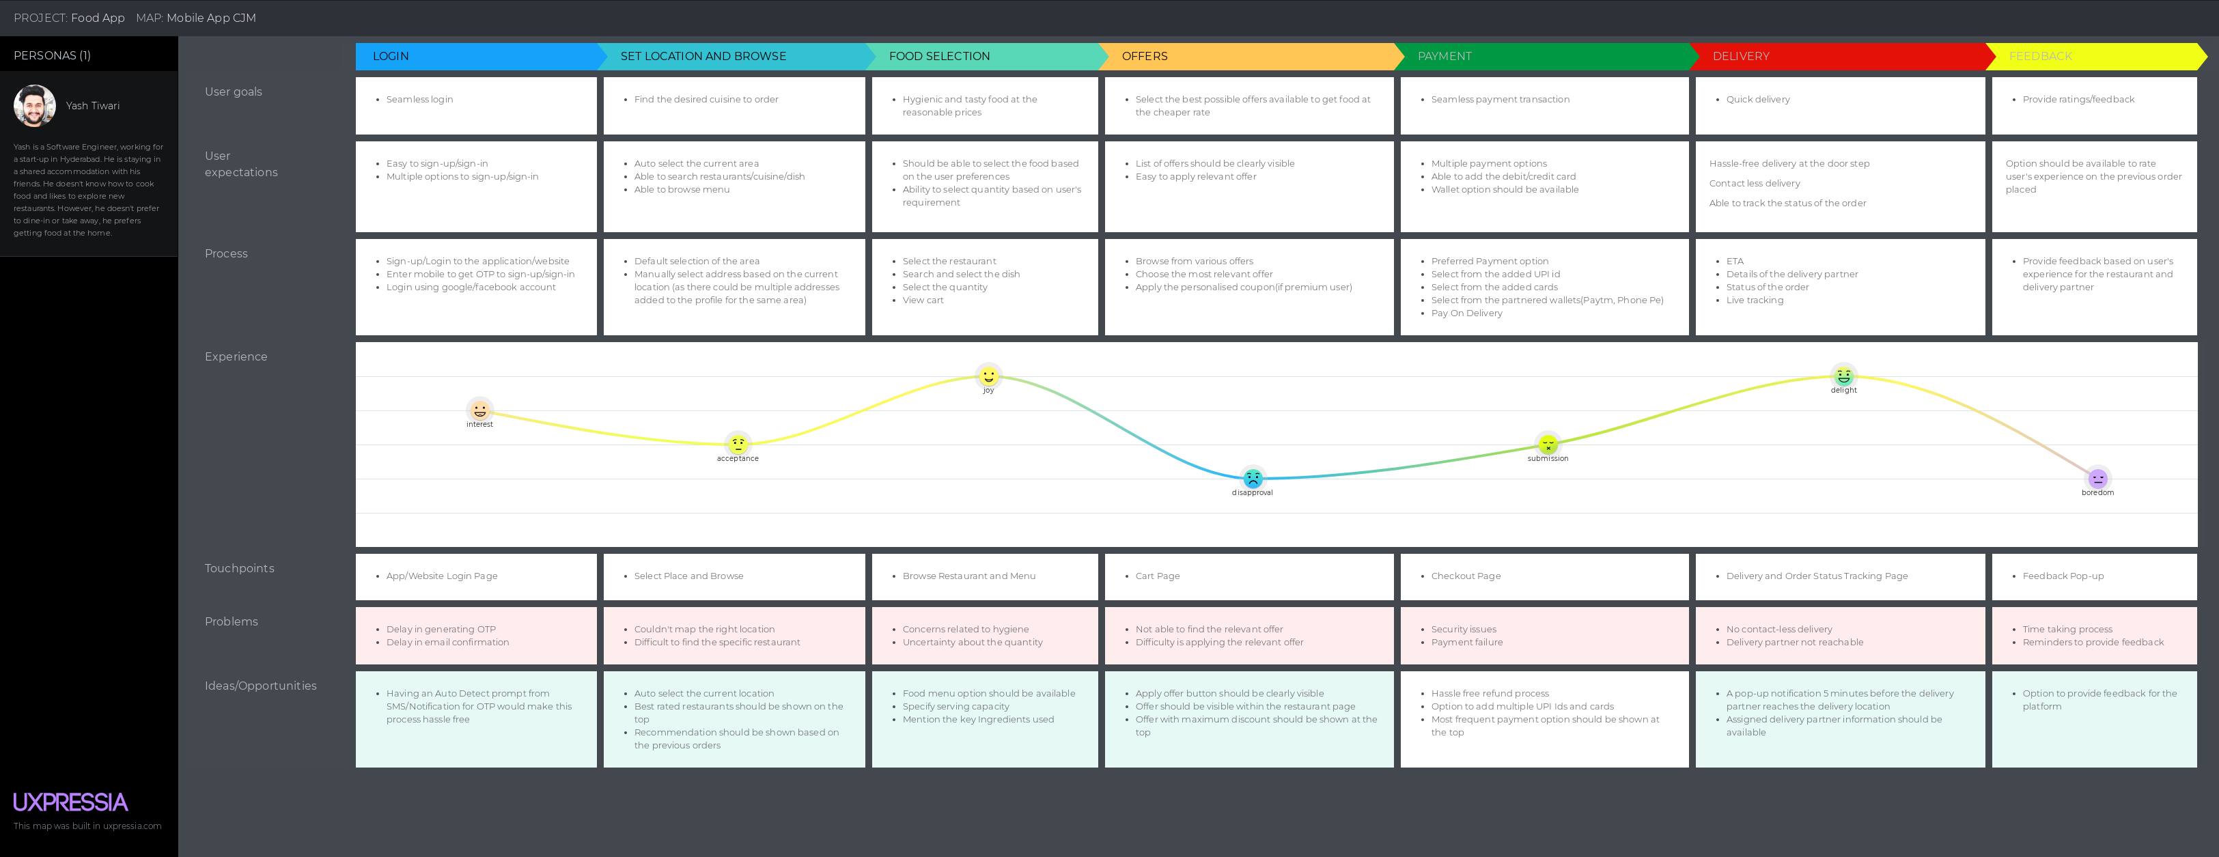
User Journey Map
Notes:
© Copyright UpGrad Education Pvt. Ltd. All rights reserved

Slide 58
Part 5: Minimum Viable Product Creation
Notes:
© Copyright UpGrad Education Pvt. Ltd. All rights reserved

Slide 59
Features/Functionalities
Sign-up/Sign-in (Mandatory)
Mobile number registration
OTP verification
Email-id (Optional)
Email-id verification
Welcome Page (New user)
Cuisine preferences
Home Page
Auto-detect current location
Recommended restaurants at the top, based on the cuisines selected
Sorting/Filtering option
Search field
Offers
Favorite restaurants
Restaurant Page
Ratings
Cost for two
Browse menu
Add to cart
Offers/Discounts
Most recommended dish
Images of food/restaurant
Filter the type of food
Delivery time
Cart Page
Details of added items
Total bill
Apply coupon field
Additional instructions
Add more items
Add address(If new user/location) or confirm address(already registered user/location)
Proceed to payment option
Payment Page
Recommended payment option for already registered users
Add card/UPI
Link wallets
Net banking
Cash on Delivery
Order confirmation (post completion of payment)
Notes:
© Copyright UpGrad Education Pvt. Ltd. All rights reserved

Slide 60
Features/Functionalities
Delivery Page
Status of order
ETA
Cancel order
Live tracking
Delivery partner details
Customer support
Add tip for delivery partner
Feedback (post delivery)
Account Page
Name
Phone Number
Email-id
Addresses
Help section
History Page
Order's history
Repeat order
Rate experience
Notes:
© Copyright UpGrad Education Pvt. Ltd. All rights reserved

Slide 61
Must Have Features
Feature | Reason behind choosing this as a ‘Must Have Feature’
User Sign-Up/Sign-In: Mobile number registration, OTP verification Home Page: Auto-detect current location, Sorting/Filtering option, Search field, and Offers Restaurant Page: Ratings, Browse menu, Add to cart, Delivery time Cart Page: Details of added items, Total bill, Apply coupon field, Address, and Proceed to payment Payment Page: Add card/UPI, Wallets, COD, and Order confirmation | These are the Must Have Features for the app to function properly so that users can order food as per their choice in a convenient manner.
Delivery Page: ETA, Cancel order, Live tracking, Delivery partner details, and Customer Support | This feature is important for users to track their order and get real time update on it
Notes:
© Copyright UpGrad Education Pvt. Ltd. All rights reserved

Slide 62
Must Have Features
Feature | Reason behind choosing this as a ‘Must Have Feature’
Account Page: Name, Phone number,Emailid,Address History Page: Order’s history | This feature is important to have so that users have the option to change their contact details when needed, and see what kind of food and from which restaurants have ordered food in the past
Notes:
© Copyright UpGrad Education Pvt. Ltd. All rights reserved

Slide 63
Nice to Have Features
Premium subscription
NPS Surveys
Minimum Order Value
One click to repeat the order from history page.
Cater personalised suggestions based on the preferred cuisines.
Recommended payment option in the payment page.
Updated body temperature of cook and delivery partners(Builds trust among the customers and encourage them to order food online in times of COVID-19)
Notification of completion of delivery.
Notes:
© Copyright UpGrad Education Pvt. Ltd. All rights reserved

Slide 64
Part 6: Sketching
Notes:
© Copyright UpGrad Education Pvt. Ltd. All rights reserved

Slide 65
Features
Page name | It’s Features/Functionalities
Sign-up/Sign-in Page | •Mobile number registration •OTP verification •Email-id (Optional) •Email-id verification
Welcome Page(New User) | •Cuisine preferences
Home Page | •Auto-detect current location •Recommended restaurants at the top, based on the cuisines selected •Sorting/Filtering option •Search field •Offers •Favorite restaurants
Notes:
© Copyright UpGrad Education Pvt. Ltd. All rights reserved

Slide 66
Features
Page name | It’s Features/Functionalities
Restaurant Page | Ratings Cost for two Browse menu Add to cart Offers/Discounts Most recommended dish Images of food/restaurant Filter the type of food Delivery time
Cart Page | Details of added items Total bill Apply coupon field Additional instructions Add more items Add address(If new user/location) or confirm address(already registered user/location) Proceed to payment option
Notes:
© Copyright UpGrad Education Pvt. Ltd. All rights reserved

Slide 67
Features
Page name | It’s Features/Functionalities
Payment Page | Recommended payment option for already registered users Add card/UPI Link wallets Net banking Cash on Delivery Order confirmation (post completion of payment)
Delivery Page | Status of order ETA Cancel order Live tracking Delivery partner details Customer support Add Tip for Delivery partner Feedback (post delivery)
Notes:
© Copyright UpGrad Education Pvt. Ltd. All rights reserved

Slide 68
Features
Page name | It’s Features/Functionalities
Account Page | Name Phone Number Email-id Addresses Help section
History Page | Order's history Repeat order Rate experience
Notes:
© Copyright UpGrad Education Pvt. Ltd. All rights reserved

Slide 69
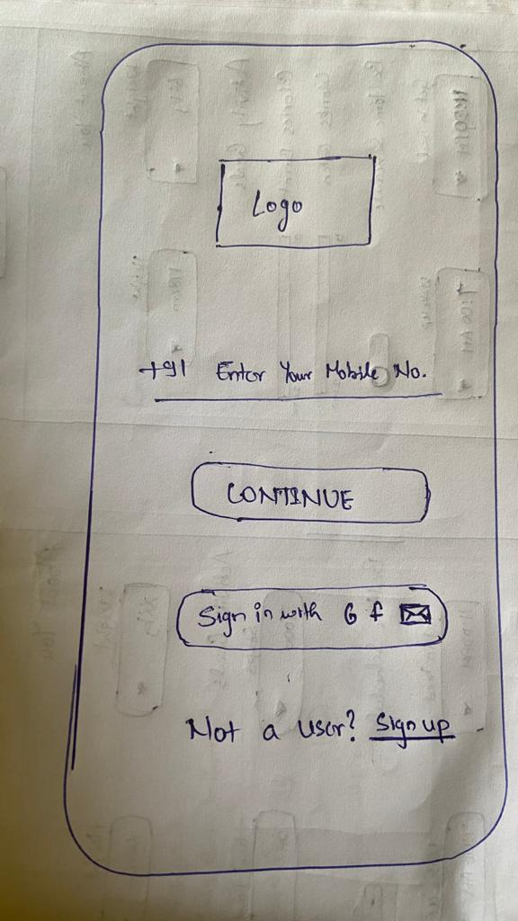
Login Page/Sign-In Page
Login Page/Sign-In Page
The login page has 4 login options
Mobile Number
Google Account
Facebook Account
Email Account
The login using mobile number is quite popular for apps where once mobile number is entered an OTP is receive and once OTP is verified the account is logged in.
User also have option to create new account if user don't have account using "Sign-up" link at bottom.
Notes:
© Copyright UpGrad Education Pvt. Ltd. All rights reserved

Slide 70
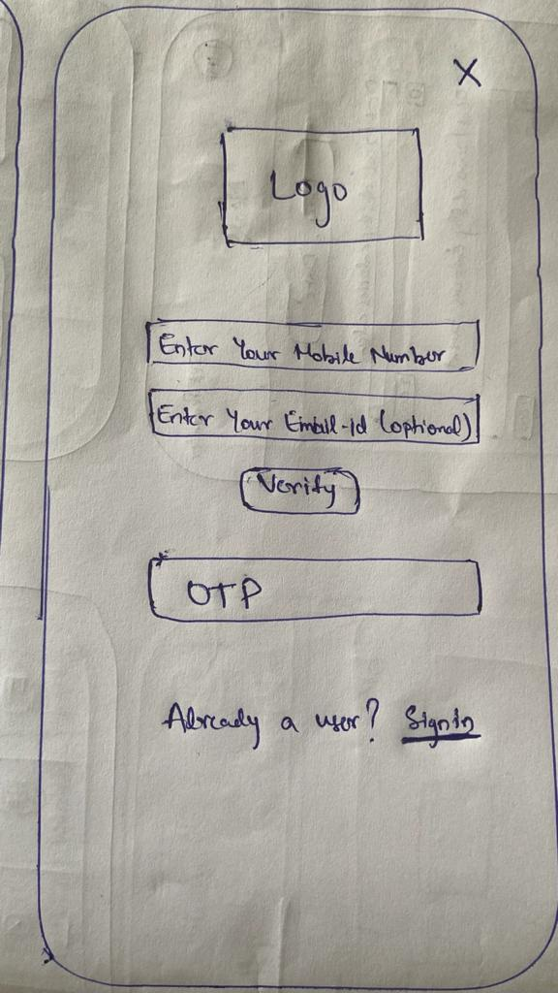
Sign-up Page
Sign-Up Page
Once the user selects "Sign-up" option on the login page user is redirected to the sign-up page.
This page contain 2 fields "Mobile number" and "Email Id". The email id field is optional.
On selecting "Verify" button the OTP is generated and the account is created.
If user has an account to login in with user can select "Sign-In" link mentioned at bottom.
Notes:
© Copyright UpGrad Education Pvt. Ltd. All rights reserved

Slide 71
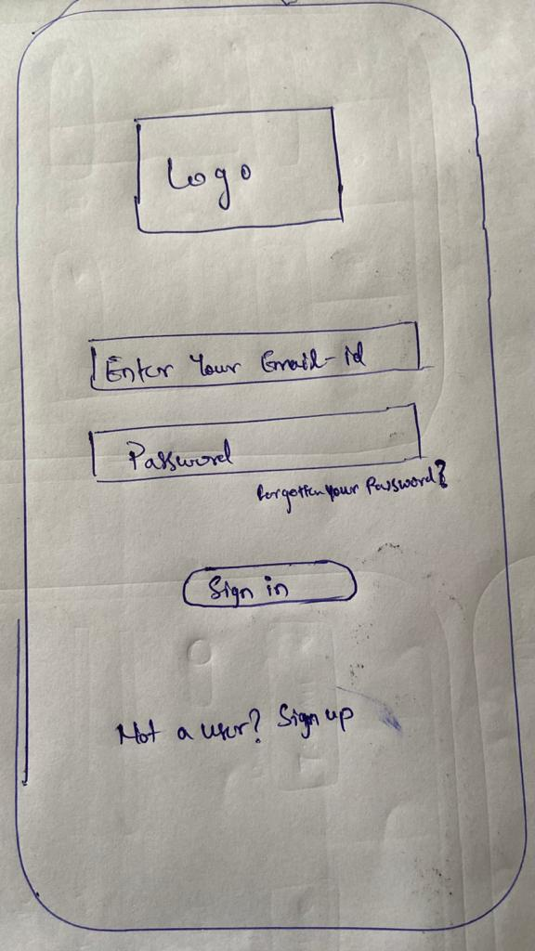
Email Sign-in Page
Email Sign-in Page
On the initial login page user has option to login using email id.
So when user selects email id login user will be redirected to this page.
This page contains 2 fields "Email Id" and "Password".
User also have option to create new account if user don't have account using "Sign-up" link at bottom.
Notes:
© Copyright UpGrad Education Pvt. Ltd. All rights reserved

Slide 72
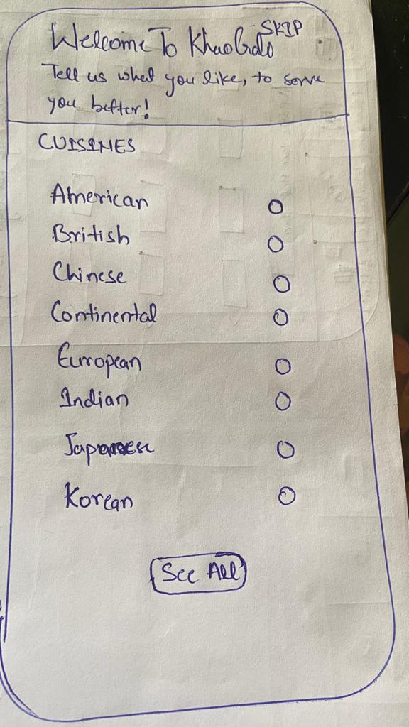
Welcome Page
Welcome Page
Once user is logged in for the first time, the user will be redirected to this Welcome page.
Welcome page is basically onboarding page where few questions are asked so we can personalise the user experience throughout the app.
Currently, for personalization we have option for selecting preferred cuisines.
According, to cuisines selected by the user in this view we would cater list of recommended restaurants in home page.
This is optional so this view comes with skip option.
Notes:
© Copyright UpGrad Education Pvt. Ltd. All rights reserved

Slide 73
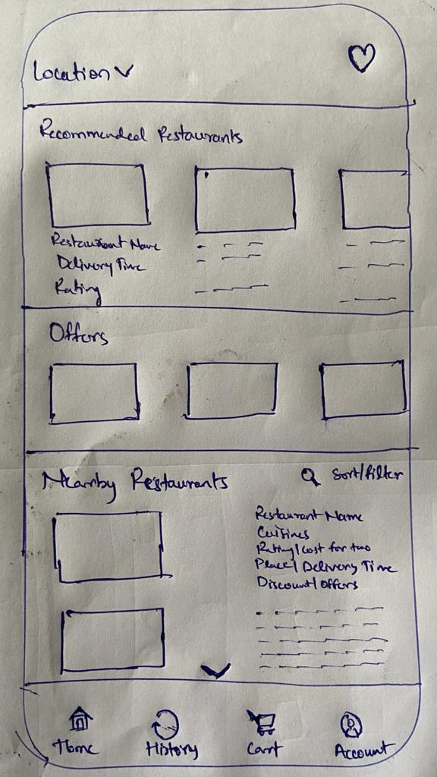
Home Page
Home Page
The home Page of the App is the page where the most user interaction occurs. Here the user has the option to navigate to all the restaurants listed with the app.
At the top of page user can change the location. When user is logged in the location will be auto set to the current location of user.
The user has the search and filter option to search specific options.
The top right the heart icon is to redirect to Favorites page.
At the bottom of every page there is sticky hamburger menu with options for Home, History, Cart and Account.
Notes:
© Copyright UpGrad Education Pvt. Ltd. All rights reserved

Slide 74
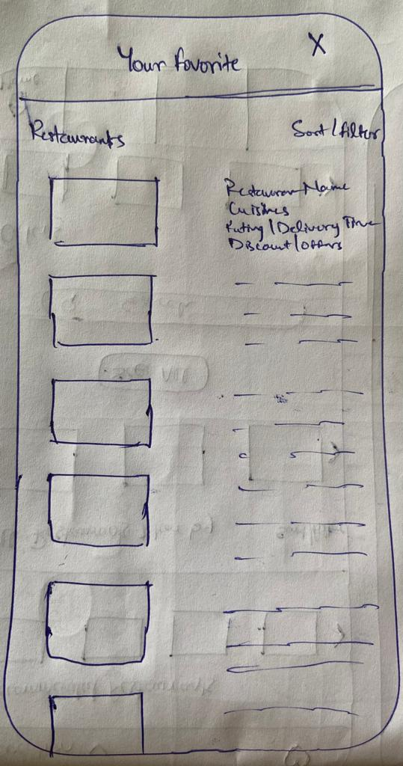
Favorite Page
Favorite Page
When user selects the heart icon at right corner of the home page user is redirected to the favourite page.
This page caters list of restaurants marked as favourite by user from Restaurant Page.
The user has the sort and filter option to search specific options.
Notes:
© Copyright UpGrad Education Pvt. Ltd. All rights reserved

Slide 75
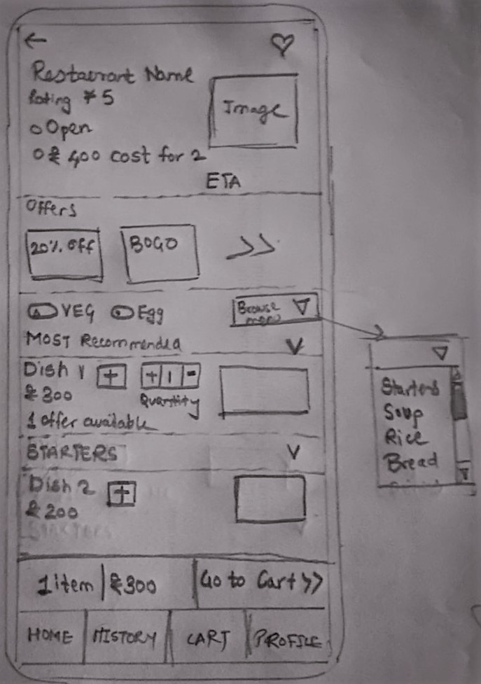
Restaurant Page
Restaurant Page
When user selects a restaurant from home page or the favourite page user is redirected to Restaurant page.
This page contains details, menu and offers of the related restaurant.
The menu has filters like veg/nonveg/egg and browse menu option where user can select the category of dish and direct go to the category.
User can select the dish and quantity to order from this page.
At the bottom the user can see the total cart cost and button "Go to Cart" to go ahead to cart to place order.
At the top right corner the heart logo is to shortlist this restaurant to favourites. The back arrow at left corner is to redirect to home page/previous page.
Notes:
© Copyright UpGrad Education Pvt. Ltd. All rights reserved

Slide 76
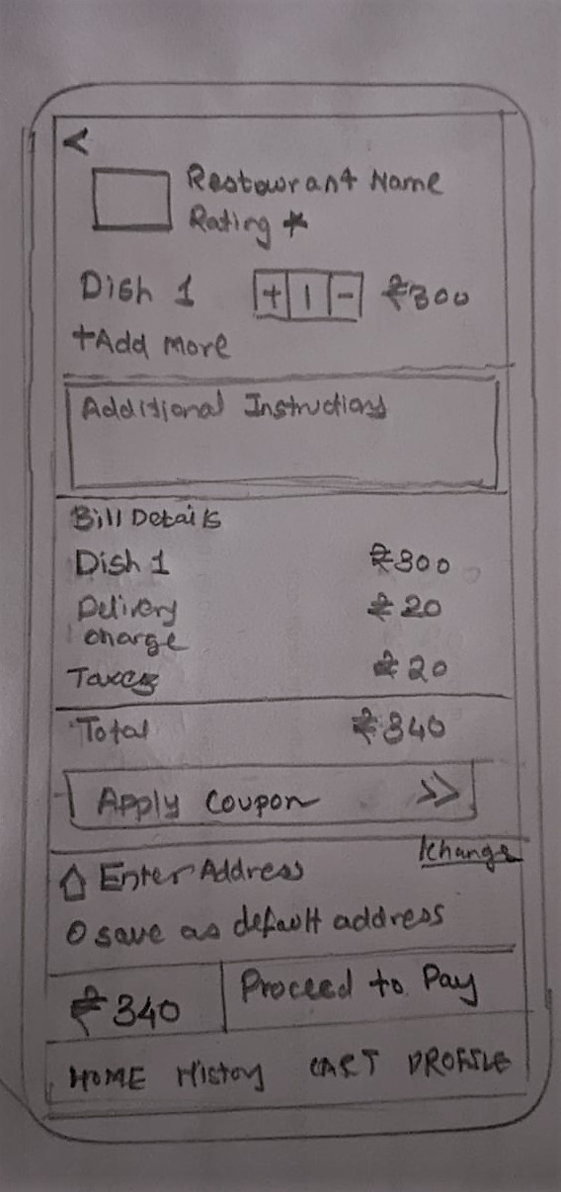
Cart Page
Cart Page
When user selects "Go to Cart" on Restaurant page or Cart option on hamburger menu user is redirected to cart page.
The cart page contains summary details of the order with option to add more items. The additional instructions field so user can provide any additional instruction to cook or delivery partner.
The page also contains bill details with micro details like delivery charges and taxes.
The page also have option to select the address and apply coupon right away.
At bottom user can see the cart total and "Proceed to Pay" will take user to payment page.
Notes:
© Copyright UpGrad Education Pvt. Ltd. All rights reserved

Slide 77
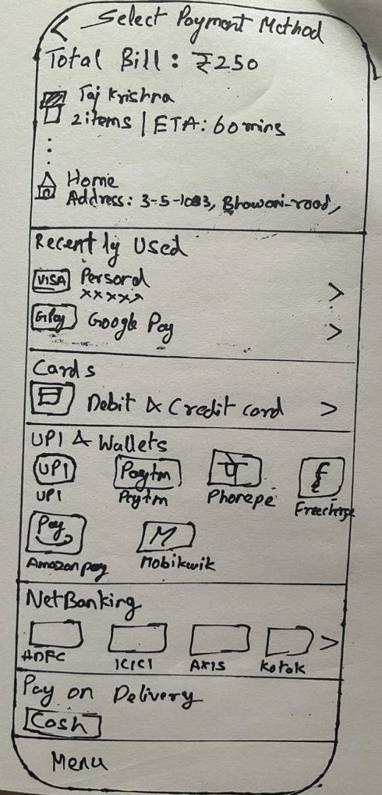
Payment Page
Payment Page
When user selects "Proceed to Pay" on cart page user will be redirected to payment page.
This page contains summary of order.
This page contains details about recently used payment methods.
This page contains payment options like cards, UPI, wallets, net banking and cash on delivery.
Notes:
© Copyright UpGrad Education Pvt. Ltd. All rights reserved

Slide 78
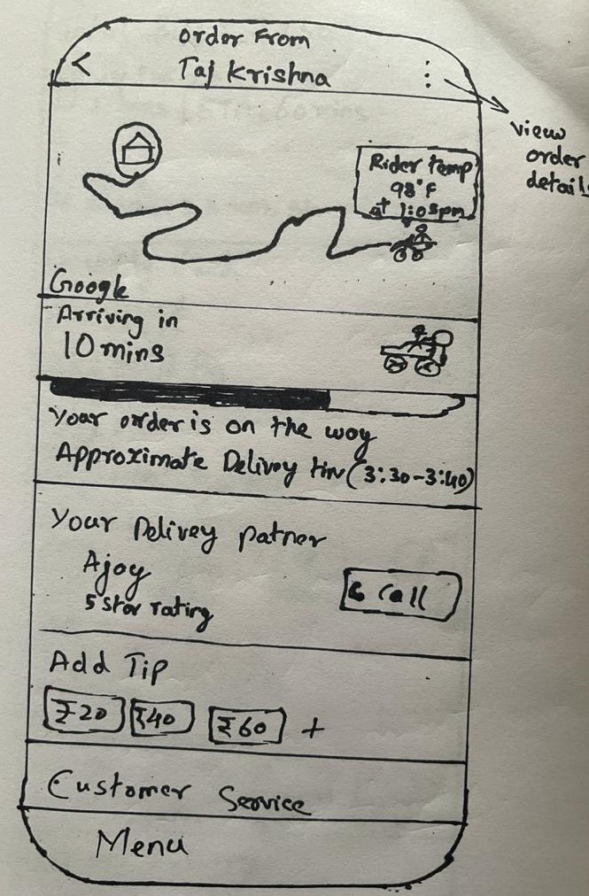
Delivery Page
Delivery Page
When the payment is completed user is redirected to delivery page.
The delivery page contains delivery partner details like contact details, location details.
The page also has feature to add tip for the delivery partner.
Top right corner there is option to view order details.
Once the delivery is completed this page will get feedback option from where user can share their valuable feedback.
The user can call delivery partner using the "Call" button.
Notes:
© Copyright UpGrad Education Pvt. Ltd. All rights reserved

Slide 79
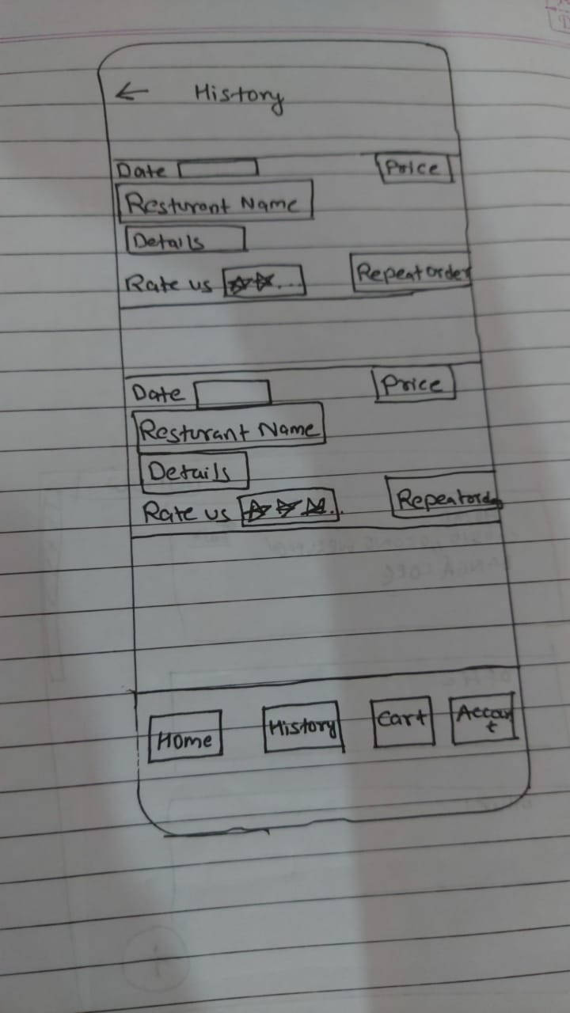
History Page
History Page
On the top, we have provided left arrow icon to go back to previous page/homepage.
User will have option to view the date, Restaurant name with order details and price.
User can also repeat the previous order in history page.
Based on their experience, user can provide ratings once.
Notes:
© Copyright UpGrad Education Pvt. Ltd. All rights reserved

Slide 80
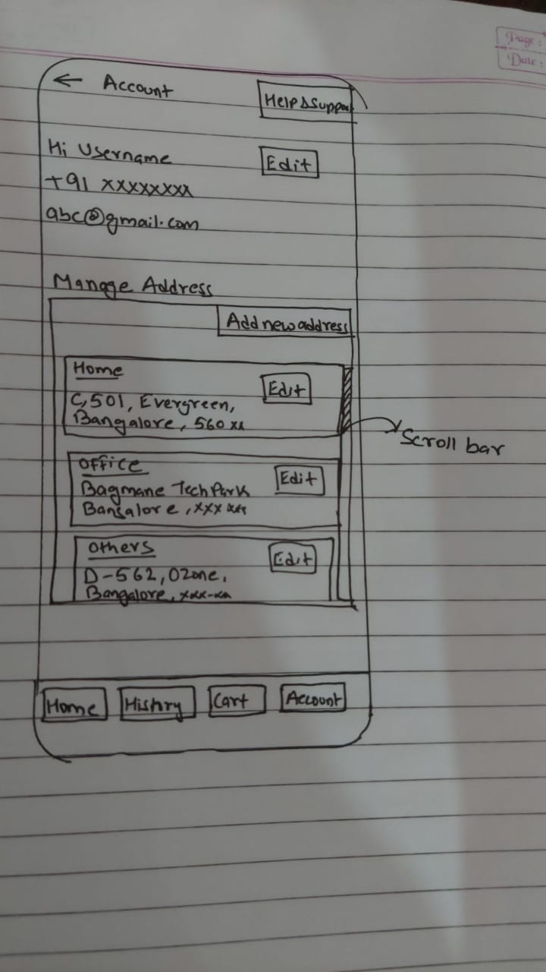
Account Page
Account Page
On the top, we have provided left arrow icon to go back to previous page/homepage. And also there is an option to go to help & support section.
User will have the option to edit registered mobile number and email id.
In manage address, user can edit or add new address under the category of Home, Office or others option.
Notes:
© Copyright UpGrad Education Pvt. Ltd. All rights reserved

Slide 81
Part 7: Wireframing and Prototyping
Notes:
© Copyright UpGrad Education Pvt. Ltd. All rights reserved

Slide 82
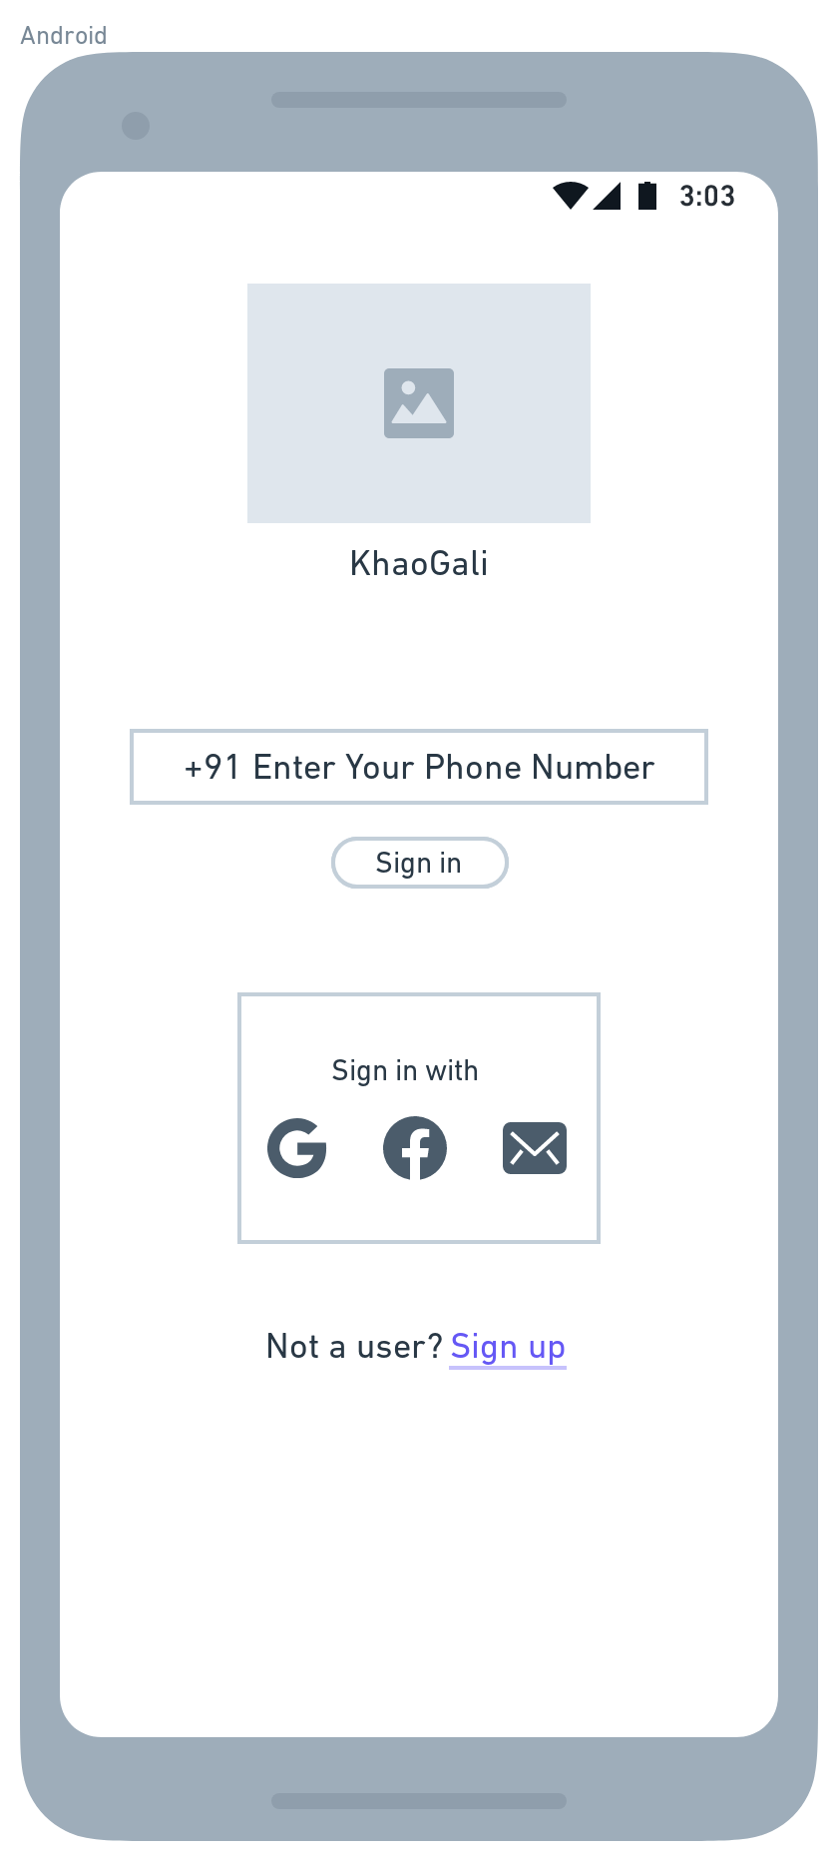
Login Page
Notes:
© Copyright UpGrad Education Pvt. Ltd. All rights reserved

Slide 83
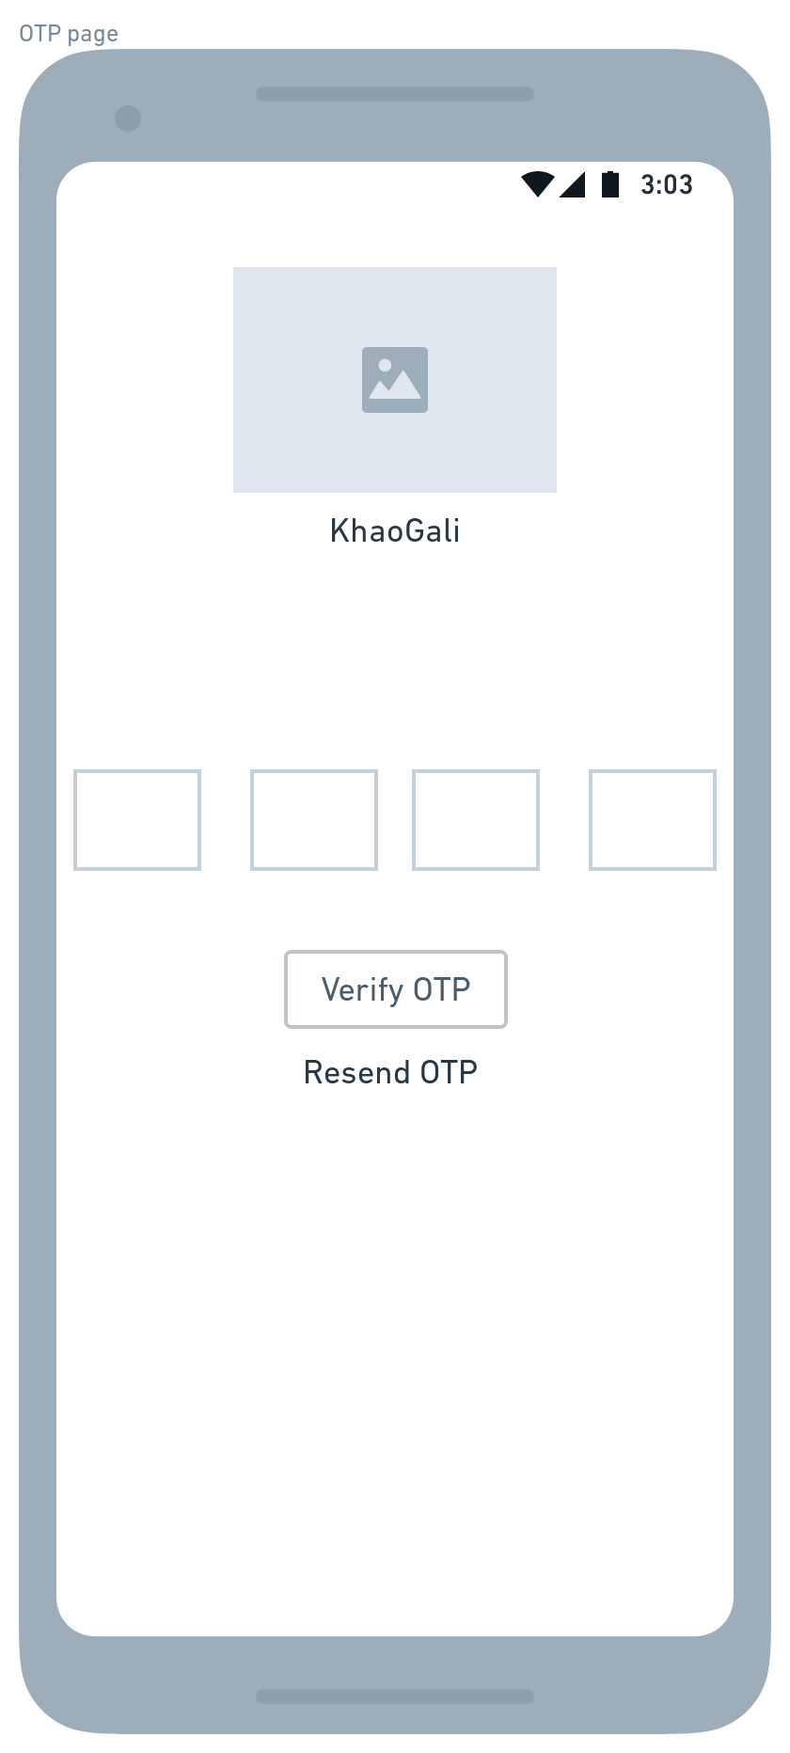
OTP Page
Notes:
© Copyright UpGrad Education Pvt. Ltd. All rights reserved

Slide 84
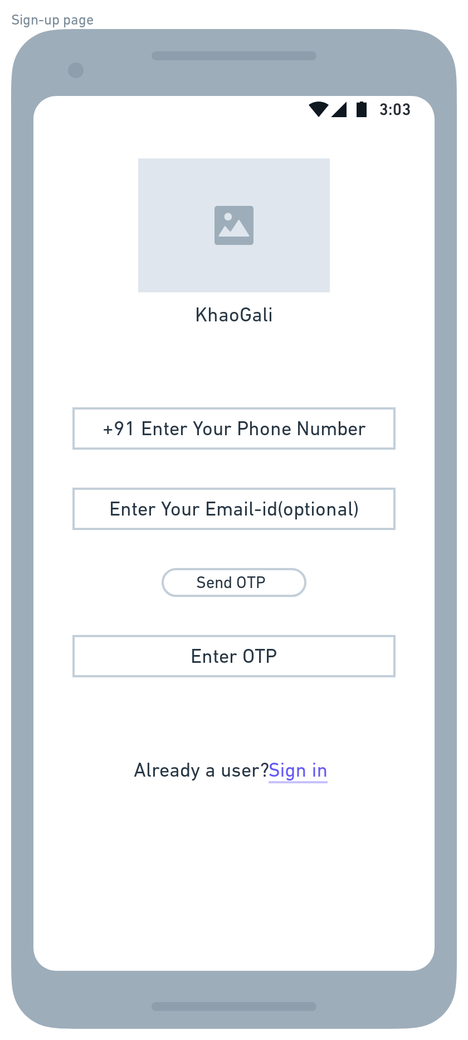
Sign-up Page
Notes:
© Copyright UpGrad Education Pvt. Ltd. All rights reserved

Slide 85
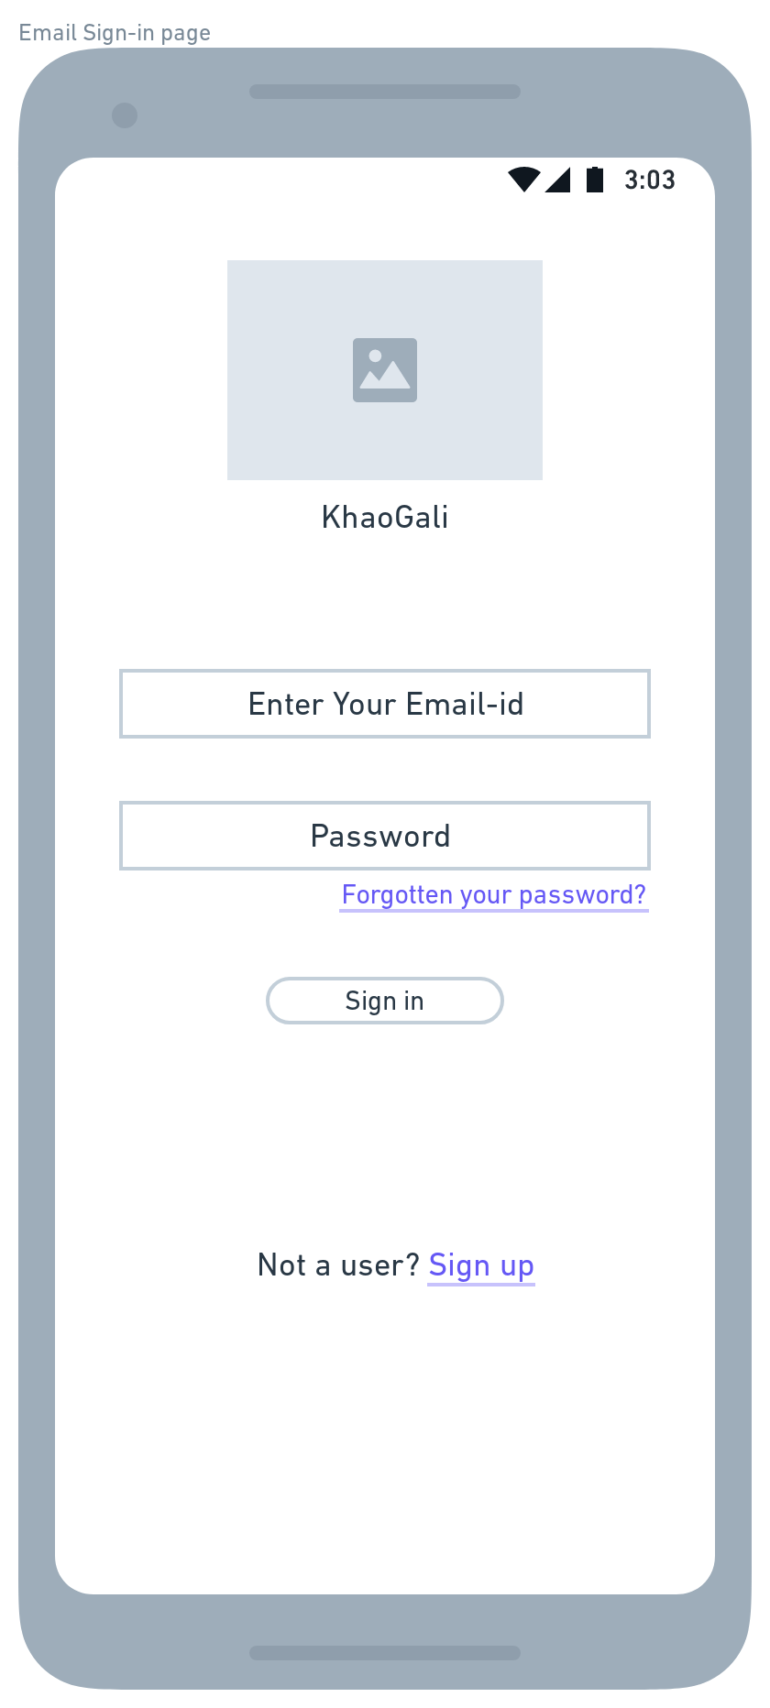
Email Sign-in Page
Notes:
© Copyright UpGrad Education Pvt. Ltd. All rights reserved

Slide 86
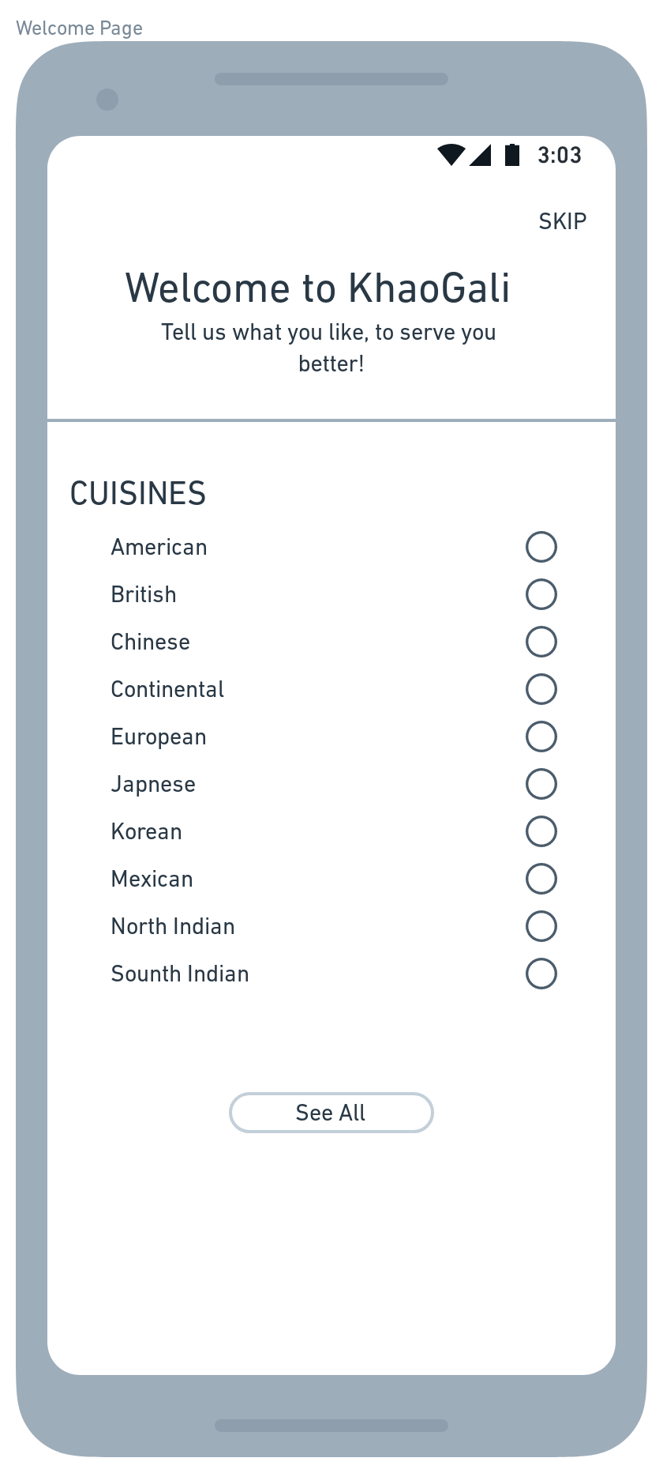
Welcome page
Notes:
© Copyright UpGrad Education Pvt. Ltd. All rights reserved

Slide 87
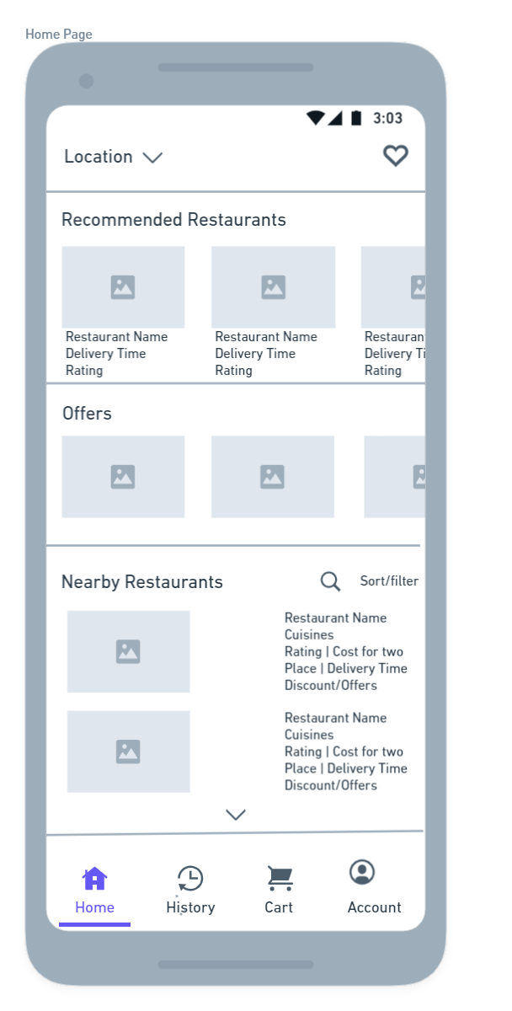
Home Page
Notes:
© Copyright UpGrad Education Pvt. Ltd. All rights reserved

Slide 88
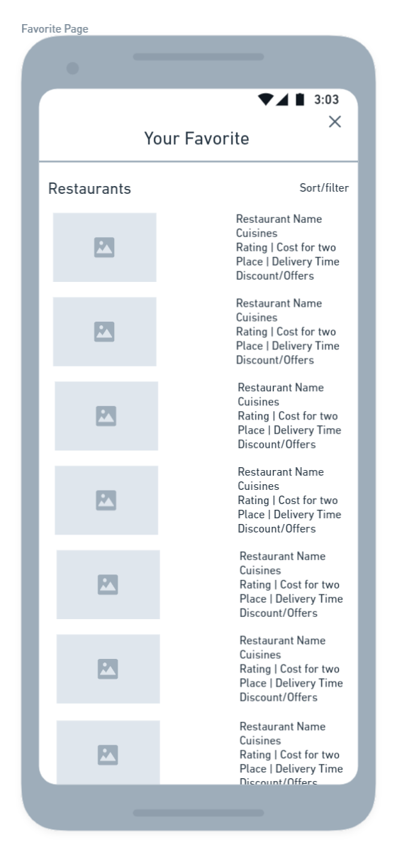
Favorite Page
Notes:
© Copyright UpGrad Education Pvt. Ltd. All rights reserved

Slide 89
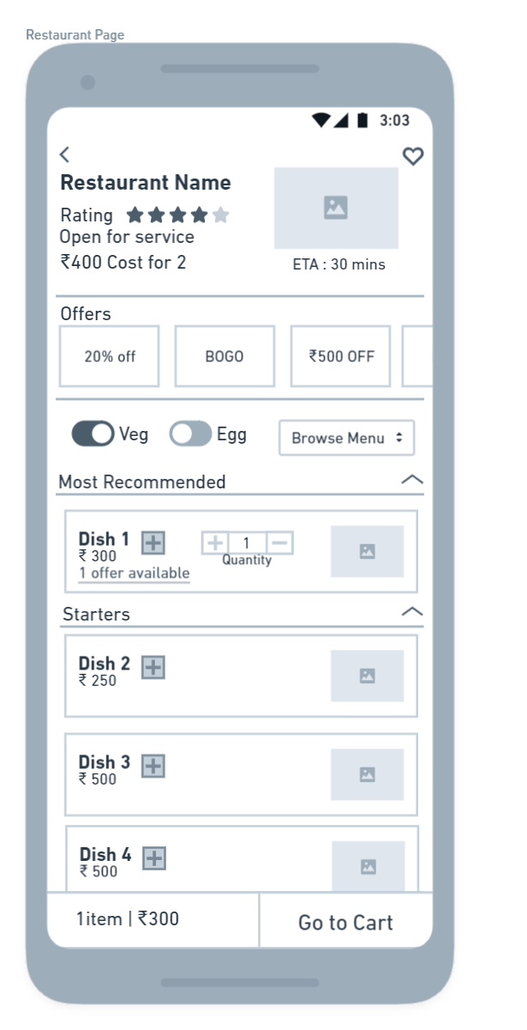
Restaurant Page
Notes:
© Copyright UpGrad Education Pvt. Ltd. All rights reserved

Slide 90
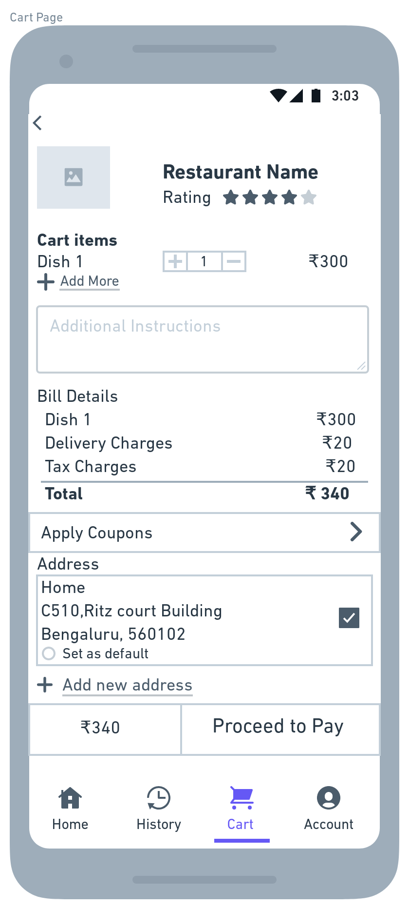
Cart Page
Notes:
© Copyright UpGrad Education Pvt. Ltd. All rights reserved

Slide 91
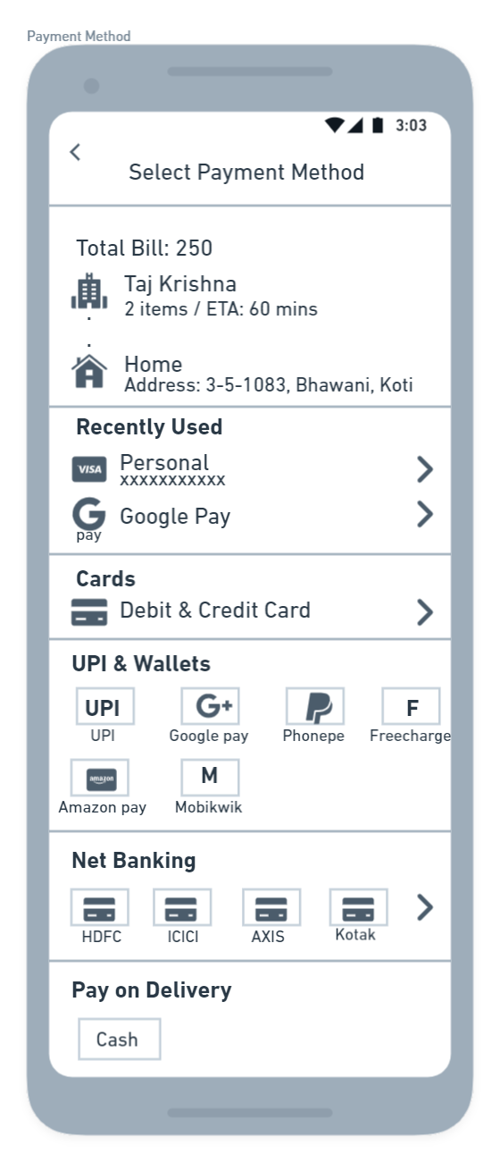
Payment Method
Notes:
© Copyright UpGrad Education Pvt. Ltd. All rights reserved

Slide 92
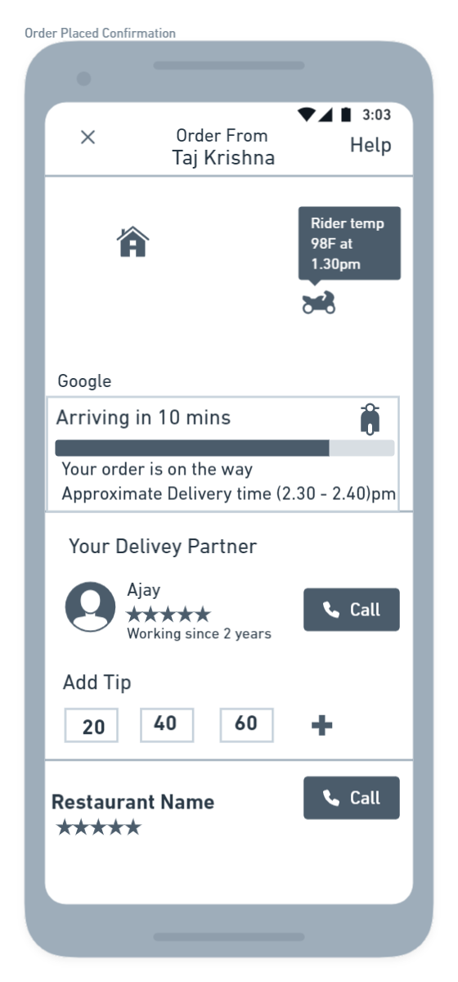
Order Tracking Page
Notes:
© Copyright UpGrad Education Pvt. Ltd. All rights reserved

Slide 93
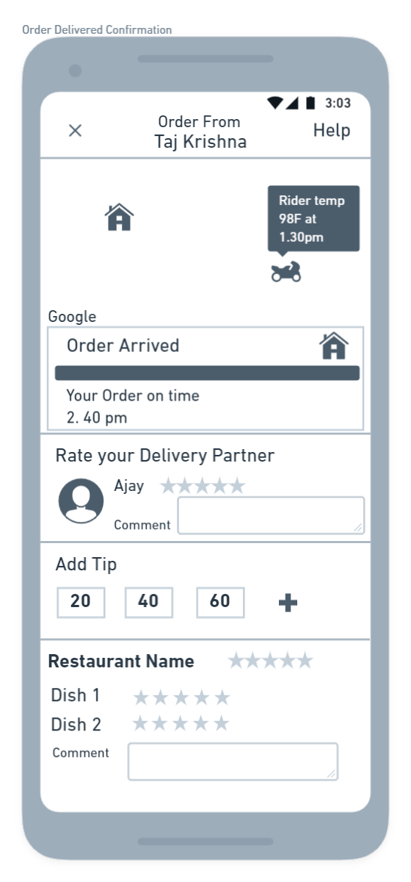
Order Confirmation Page
Notes:
© Copyright UpGrad Education Pvt. Ltd. All rights reserved

Slide 94
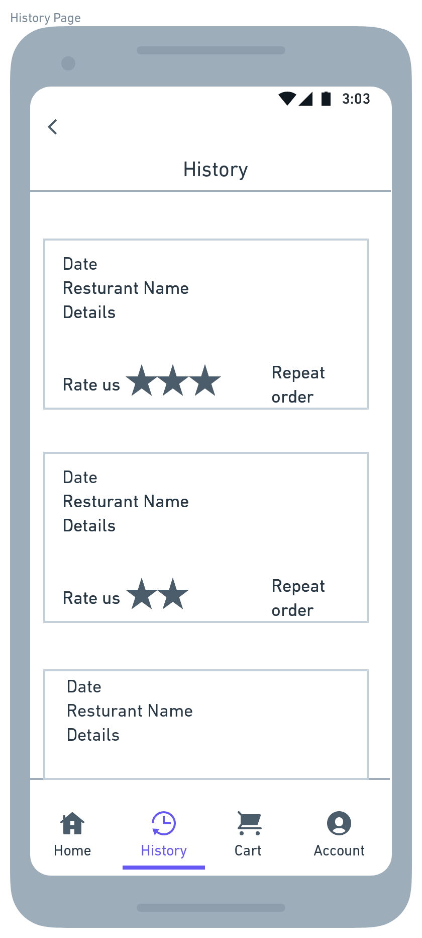
History Page
Notes:
© Copyright UpGrad Education Pvt. Ltd. All rights reserved

Slide 95
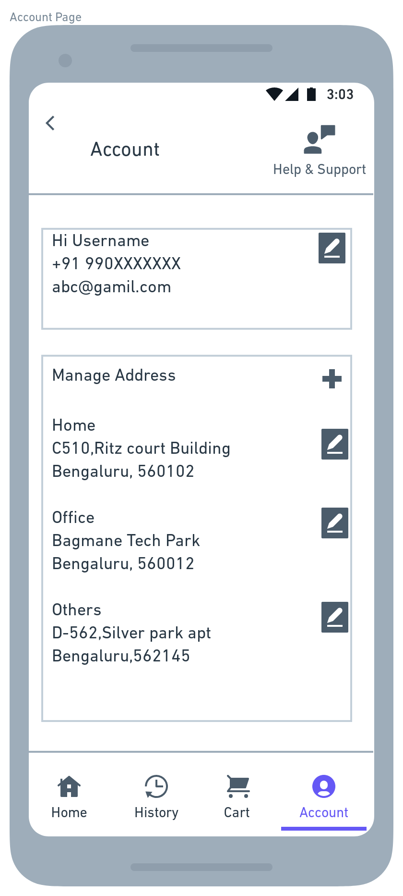
Account Page
Notes:
© Copyright UpGrad Education Pvt. Ltd. All rights reserved

Slide 96
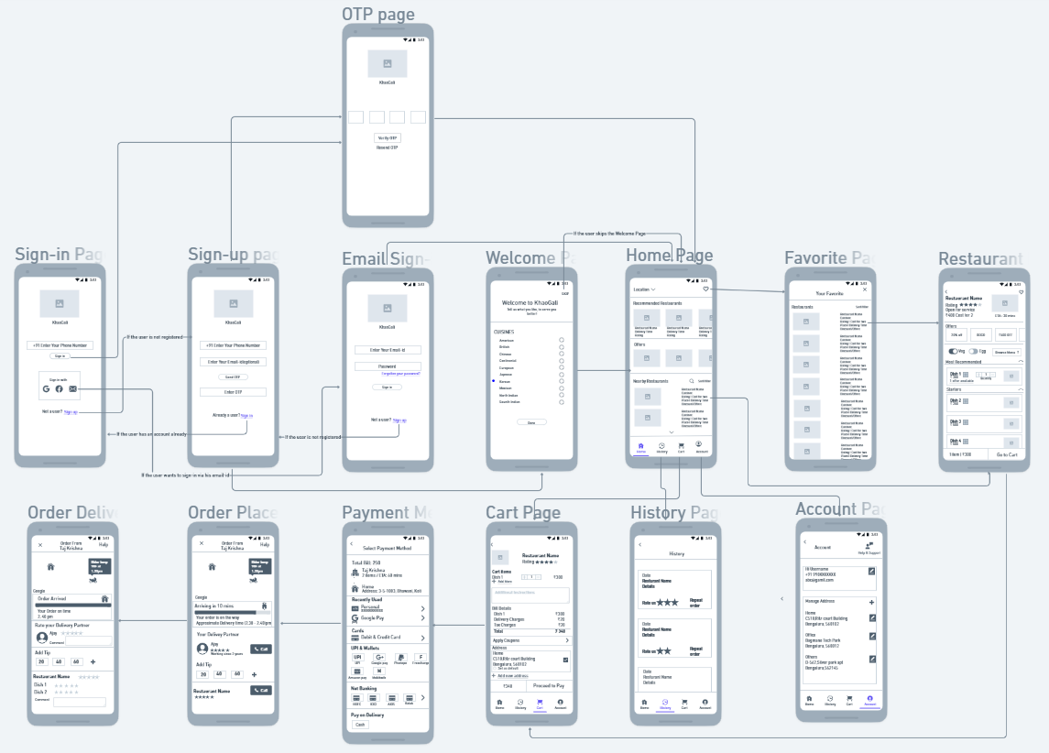
Navigational Flow
Place the navigational flow structure here
Notes:
© Copyright UpGrad Education Pvt. Ltd. All rights reserved

Slide 97
Tools used
Wireframing | Whimsical
Prototyping | Marvel App
Notes:
© Copyright UpGrad Education Pvt. Ltd. All rights reserved

Slide 98
Prototyping
Prototyping | https://marvelapp.com/prototype/72gci76
Notes:
© Copyright UpGrad Education Pvt. Ltd. All rights reserved

Slide 99
Disclaimer: All content and material on the UpGrad website is copyrighted material, either belonging to UpGrad or its bonafide contributors and is purely for the dissemination of education. You are permitted to access print and download extracts from this site purely for your own education only and on the following basis:
You can download this document from the website for self-use only.
Any copies of this document, in part or full, saved to disc or to any other storage medium may only be used for subsequent, self-viewing purposes or to print an individual extract or copy for non-commercial personal use only.
Any further dissemination, distribution, reproduction, copying of the content of the document herein or the uploading thereof on other websites or use of content for any other commercial/unauthorized purposes in any way which could infringe the intellectual property rights of UpGrad or its contributors, is strictly prohibited.
No graphics, images or photographs from any accompanying text in this document will be used separately for unauthorised purposes.
No material in this document will be modified, adapted or altered in any way.
No part of this document or UpGrad content may be reproduced or stored in any other web site or included in any public or private electronic retrieval system or service without UpGrad’s prior written permission.
Any rights not expressly granted in these terms are reserved.

